Slide 1


Emergency Management Sector Deployments
Director’s Guideline for Civil Defence Emergency Management Groups
(DGL 25/24)

Slide 2
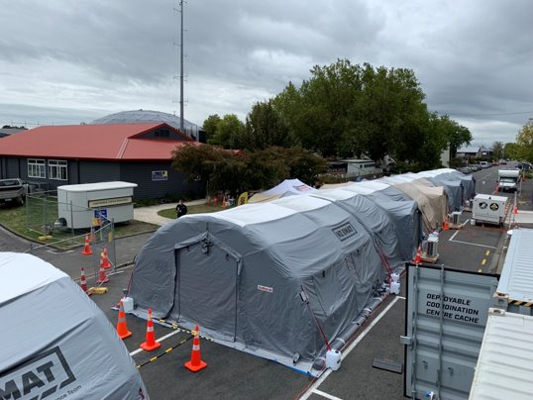
Why have Sector Deployments?
CDEM Groups may be overwhelmed by the scale of a response
Proactively supporting CDEM Group in need
Giving home response staff a well-deserved break
Utilising experienced and specialist personnel in NZ
Mainly for emergency events from Medium to Catastrophic

Slide 3
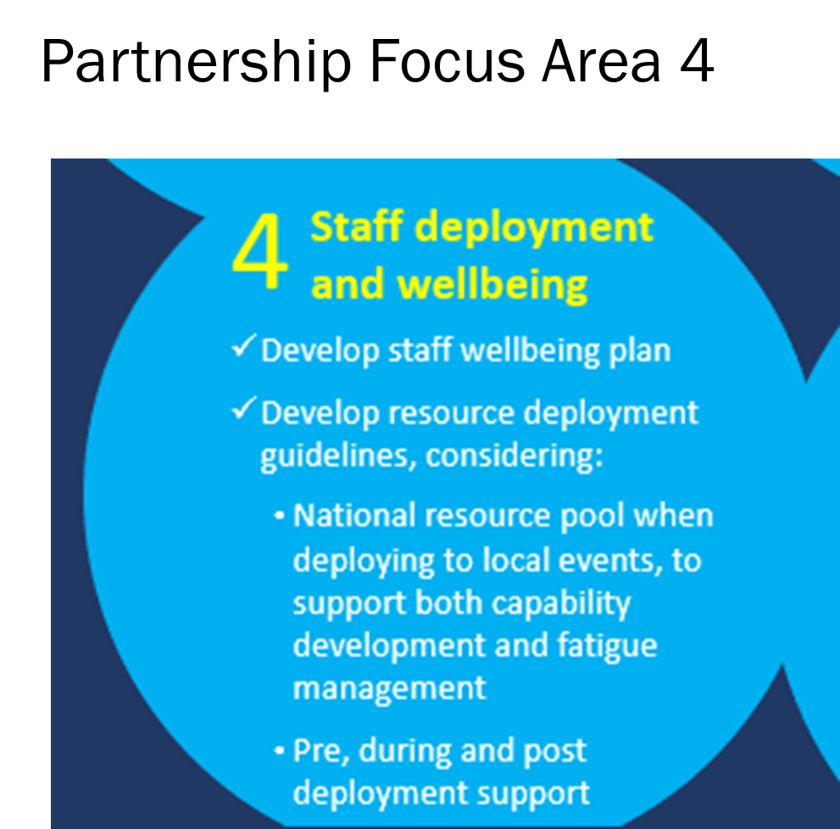
Sector Deployment developments
Focus area in Partnership Charter 2022 between CDEM Groups and NEMA
A priority for Emergency Management Leadership Group (EMLG)
Lessons learnt from previous emergency events
Impacted areas utilise Inter-Group arrangements first
NCC/NCMC may agree to coordinate sector deployments if impacted region is overwhelmed

Slide 4
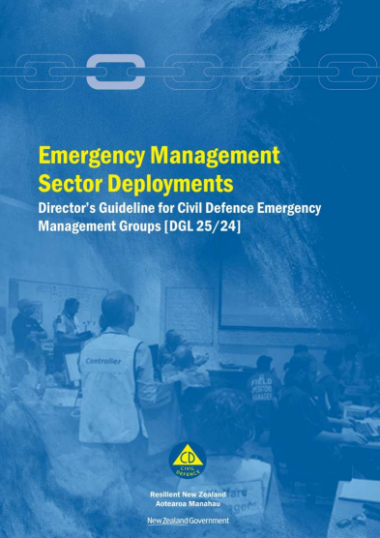
One deployment guide for the CDEM Sector
Combining deployable response elements into one guide
Throughout the Readiness, Response, and Recovery phases
Readiness for deployment, pre-deployment, deployment, and post-deployment guidance
Best practice and guidance for the sector
Notes:
appendices for unique deployment info and nuances
teams to still own and maintain SOP’s unique to their team

Slide 5
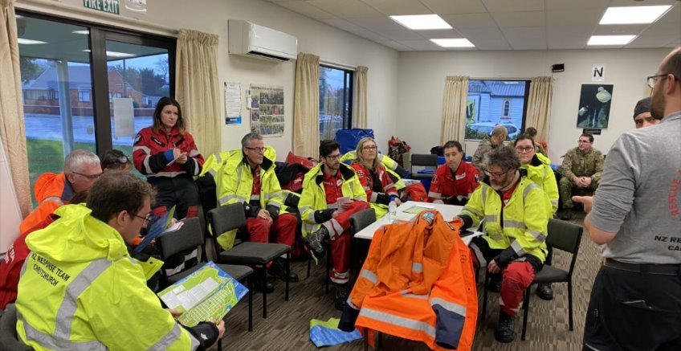
Purpose of the DGL?
Consistent approach and best practice for CDEM Sector
Lessons learnt from previous events incorporated into DGL (including NISWE)
Identification of roles and responsibilities
Ensuring health and wellbeing are a priority in line with H&SaW Act 2015
Identifying overlapping responsibilities under the H&SaW Act 2015
Ensuring the right person, right place, right time

Slide 6





Response elements (teams) using DGL
Sector Surge staff
New Zealand Response Team (NZRT)
Emergency Management Assistance Team (EMAT)
NEMA Regional Emergency Management Advisor (REMA’s)
Other NEMA Deployable elements
…………………………………………………………………
Public Service Commission Mobility Hub deploying public service staff

Slide 7
Sector Deployment Principles (summarised)
Overarching deployment principles agreed by Emergency Management Leadership Group (EMLG), these form the basis of the DGL:
Operational experience – adds greater depth to CDEM Sector
Proactive “no regrets” basis
Financial arrangements – indirect and direct costs
Requestor responsible to be prudent and efficient with requests
Impacted area can use staff for BAU and BCP functions
Order of requesting staff – local to regional to national

Slide 8
Sector Deployment Principles (summarised), continued
Willing to deploy, qualified and experienced in a CIMS function role
Some areas have a larger hazard scape and little capacity
ECC’s to coordinate requests for regions. More than one region – ECC’s work with NCC/NCMC
CC’s to manage through Logistics Personnel sub-function
Home Agencies to provide support and connect with Deployees
Requesting and Home Agency are joint PCBU – need to consult on risk

Slide 9
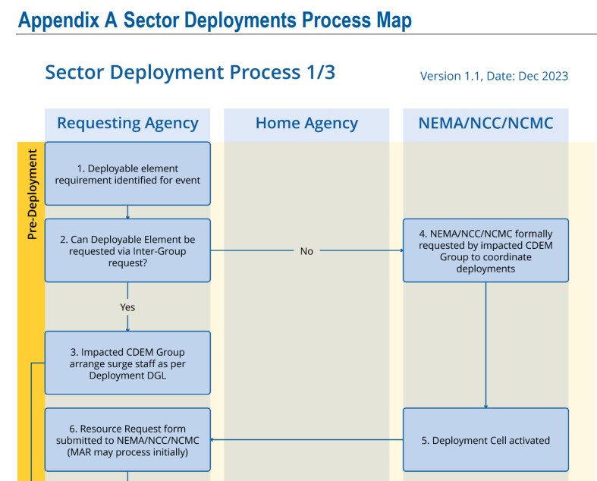

Slide 10
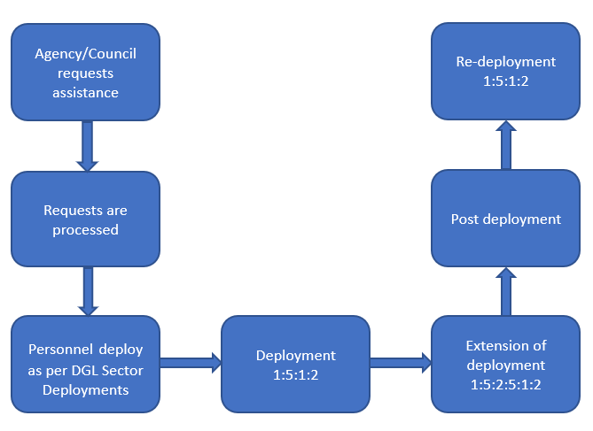
The Deployment Cycle

Slide 11
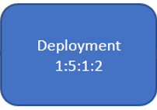
The Deployment Cycle ratio
The deployment cycle consists of the following ratio: 1:5:1:2
1 day to travel to the event location
5 days operating inside the CC
1 day travel to home destination
2 days stand down, managed by the employee’s Home Agency

Slide 12
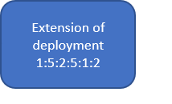
The extension of deployment ratio
1 day to travel to the event location
5 days operating inside the CC
2 days stand down (24 hrs minimum*)
5 days operating inside the CC
1 day travel to home destination
2 days stand down, managed by the employee’s Home Agency
* 2 days stand down recommended, 24 hours minimum rest depending on nature of environment

Slide 13
Pros & Cons of deploying sector staff
Advantages:
Refreshed and enthused staff
Give worn out staff a break
Could have a high level of experience or subject matter experts
Offer a fresh perspective
Can cover night shift
No home commitments - focus mainly on response
Rewarding and a capability development opportunity

Slide 14
Pros & Cons of deploying sector staff, continued
Disadvantages:
Little local area knowledge
Don’t know communities
Don’t know processes of local area
Don’t know local EM system contacts
Need a lot of admin prep, logistics support & wellbeing checks
Short time – 5 days unless extended to 10+ days
High cost with flights, transport, accommodation, food, etc

Slide 15
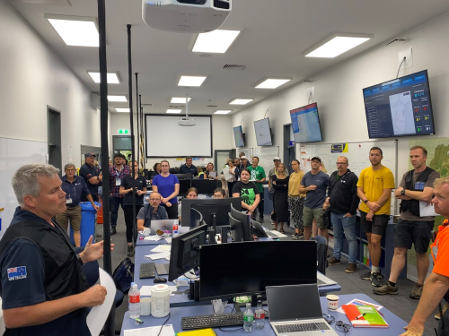
Sector deployment challenges
Some function managers can be difficult to source e.g. PIM, Welfare
Finding the right person for the role with the right level of experience
Flight & accommodation availability
Rental car availability
BAU versus response roles – some experienced staff are required for BAU

Slide 16
Contact:
For general enquiries, contact the National Emergency Management Agency (NEMA).
Contact Address: 147 Lambton Quay,
PO Box 5010,
Wellington 6140.
Phone: 04 830 5100
Email: emergency.management@nema.govt.nz
Website: www.civildefence.govt.nz

