Slide 1
Risk Assessment DGL – PowerPoint Template: Notes
This template can be used to create a PowerPoint for use in a risk assessment workshop
Slides 3 and 17-21 contain standard information regarding the environments (slide 3) and the risk assessment process (slides 17-21)
Other slides provide a framework for the presentation and should be customised to match the hazard and region.

Slide 2
Introduction
Welcome
Why are we here?
Overview of what we are going to do:
Some presentations
A scenario
Assess a range of elements
Toilets and house keeping

Slide 3
ENVIRONMENTS
Today’s workshop will assess a range of elements within the following environments:
Social:
Impacts on the physical health of individuals. Displacement of households.
Impacts to community welfare and services
Economic:
Costs to individuals, businesses and government. Impacts on employment and productivity.
Built:
Impacts to infrastructure, services and lifelines.
Impacts to buildings
Natural:
Impacts on the ecosystem; including air and water quality, impacts to biodiversity and soil quality.
Notes:
We are going to assess the xxx scenario in light of a range of elements (things) belonging to the following environments

Slide 4
The xxx Region
Provide context for the CDEM region with key facts and a map.
Provide guidance if CDEM group boundaries are not aligned with regional boundaries (e.g. Otago)

Slide 5
Regional Profile – Social
Some examples of information to include are provided below
Households in xxx region – xx
Population of xxx region - xx
Concentration of young people in town A and older people in the district B
Scattered tourists and students
Community services
Healthcare services in the region
Education
Regional/rural population
Aging population
Essential services
International and domestic tourist profile

Slide 6
Regional Profile - Built
Some examples of information to include are provided below:
Region home to many historic unreinforced masonry buildings (URM)
Critical infrastructure routes
Key transport links

Slide 7
Regional Profile - Economy
Some examples of information to include are provided below:
Gross regional product – $
Sensitive to loss of reputation due to reliance on tourism
Industry Types
Agriculture: Wool
Horticulture: None
Tourism
Education
Export sectors

Slide 8
Regional Profile - Environment
Some examples of information to include are provided below:
Flora and Fauna
National parks

Slide 9
Scenario A
Hazard Overview

Slide 10
Hazard A
Overview of the hazard

Slide 11
Overview of Scenario A (including exposure of elements) Avoid specific statements about the level of impact to ensure the assessment is not influenced.

Slide 12
Add maps (if helpful to explain the scenario).

Slide 13
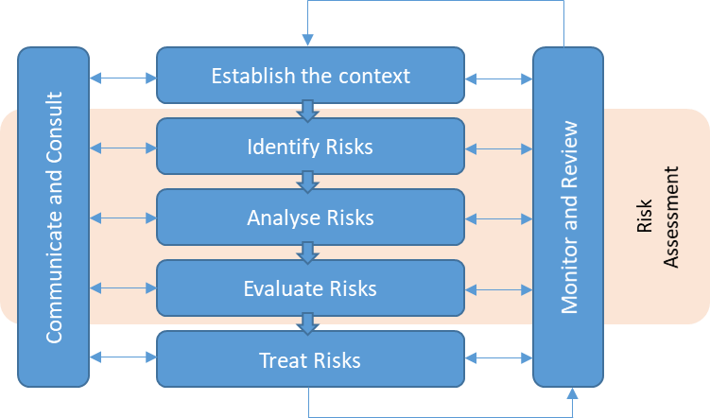
RISK ASSESSMENT PROCESS
Methodology and tools:
Director’s Guideline ‘Risk assessment guidance for CDEM Group planning’
Following the international Risk Management Standard
Queenstown 1999
Notes:
The risk assessment process involves the identification, analysis and evaluation of risk. Today’s workshop focuses on analysing the risk.

Slide 14
RISK ASSESSMENT PROCESS
Today’s workshop focuses on the ‘Analyse Risks’ step
Queenstown 1999

Slide 15
RISK ANALYSIS PROCESS
For the purpose of this assessment imagine the event IS taking place
For each element on your consequence table we will collectively:
Step 1.
Assess the maximum possible Consequence
Step 2.
Assess the Confidence of the decision
Step 3.
Plot on to the risk matrix (automatic)
The decision will be recorded in the Risk Analysis Tool, along with notes summarising the discussion.
Notes:
Taking good notes is essential to provide context for the decision made. Context is particularly important for the evaluate and treat stages.

Slide 16
STEP 1: ASSESS THE MAXIMUM POSSIBLE CONSEQUENCE
 | Base Descriptors
 | No impact or some local management but no special management required outside of BAU | Some local specialised management at district level, may be of interest to regional authorities | Significant local specialised management and multi-district management. Of interest to regional authorities. | Multi-functional, Multi-district specialised management. Regional authorities involved. Of interest to national agencies | Multi-functional, regional and national specialised management. Of significant interest to national agencies, may be of interest to international partners.
 | Insignificant | Minor | Moderate | Major | Extreme
Social Environment
Deaths | No deaths | 1 - 2 | 3-10 | 11-99 | >100
Injuries and illness | No additional management required | Managed through existing district surge plans | Additional support required from within the region | Additional support required from outside the region | Significant national surge required
Households in need of accommodation | No assistance required | Local agencies manage within existing resources | District agencies manage through existing plans using paid accommodation | Emergency shelter required, regional coordination | Multiple emergency shelters established, relocations outside of the region
Displaced households | Negligible displacement | 1-10 households | 11-100 households | 101-500 households | >500 households
SAMPLE
Move right to left
Notes:
Note: the consequence table shown here has not been updated to reflect the new base thresholds
For each line on the consequence table (element) start on the right side of the consequence table. First ask “could the consequence of the scenario on this element meet this criteria” if the answer is no, continue to move to the left until reaching criteria which match the possible level of consequence.

Slide 17
STEP 2: ASSIGN CONFIDENCE LEVEL
 | Lowest | Low | Moderate | High | Highest
Supporting Evidence | • No historical events • No scientific model | • Anecdotal information of historical events • Scientific model which could be applied with significant modification | • Historical event of similar magnitude in a comparable community of interest • Relevant scientific model available | • Recent historical event of similar magnitude in a directly comparable community of interest • Good scientific model available | • Recent historical event of similar magnitude to that being assessed in the community of interest • Highest quality scientific model
Expertise | No expertise is available | Expertise is available | Relevant expertise is used to make decision | Relevant expertise is highly influential in the decision | Relevant and demonstrated expertise available and highly influential in making the decision
Participant Agreement | Fundamental disagreement of assessment | Disagreement of major aspects of assessment | Disagreement of minor aspects of assessment | Agreement of assessment | Strong agreement of assessment
Notes:
For each element, decide on a level of confidence. Unlike the consequence table (where the choice must be based on the criteria), the confidence table is used as guide. The assigned confidence rating can be selected based on single line or a combination of the three lines listed in the table.

Slide 18
STEP 3: VIEW ELEMENT RISK LEVEL
Likelihood | Consequence
 | Insignificant | Minor | Moderate | Major | Extreme
Almost Certain | Medium | High | Very High | Critical | Critical
Likely | Medium | High | Very High | Very High | Critical
Possible | Low | Medium | High | Very High | Very High
Unlikely | Low | Low | Medium | High | Very High
Rare | Low | Low | Low | Medium | High
Example: likelihood possible, consequences major = Risk level VERY HIGH
Note: The likelihood is pre-determined as part of scenario development.
Notes:
The Risk Assessment and Summary Tool will automatically provide a risk level based on the scenario likelihood and the consequence rating assigned to the element.

Slide 19
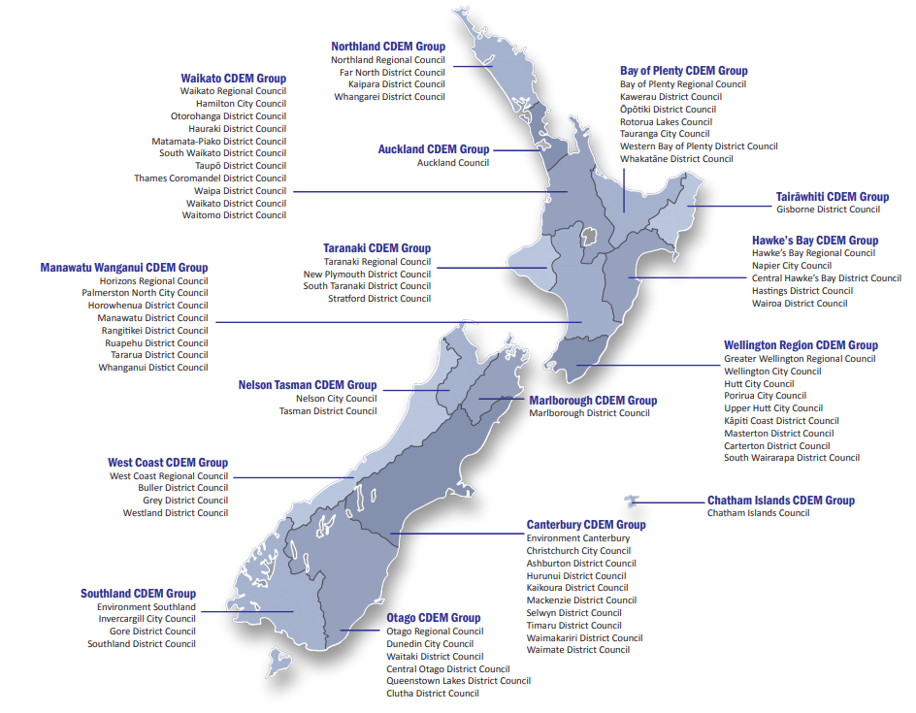
Remember: this assessment is for the whole CDEM Group Area
Notes:
Remind participants that the assessment is for the whole Group area. For example the loss of a key road may be rated as ‘major’ for a community but rate as ‘minor’ for the Group area based on the consequence criteria.

Slide 20
Scenario B
Hazard Overview

Slide 21
Hazard B
Overview of the hazard

Slide 22
Overview of Scenario B (including exposure of elements) Avoid specific statements about the level of impact to ensure the assessment is not influenced.

Slide 23
Add maps (if helpful to explain the scenario).

Slide 24
Debrief

