Slide 1
Ministry of Civil Defence & Emergency Management Campaign Monitoring Research
July 2012

Slide 2
Background and objectives
Background
The Ministry of Civil Defence and Emergency Management needs to shift people’s level of preparedness for disasters.
The Get Ready Get Thru social marketing campaign began in June 2006 and has now been running for six years.
This survey builds upon a previous 2006 pre-campaign benchmark survey, and five annual tracking surveys conducted from 2007 to 2011. All surveys are carried out in April and May each year, with the exception of the 2011 survey which was delayed by four weeks due to the February 2011 Christchurch earthquake.
Objective
To measure New Zealand residents’ disaster preparedness, and to assess the effectiveness of the campaign over time.

Slide 3
How the survey was carried out
Methodology
Random telephone interviewing of New Zealand residents aged 15 years and over. One thousand two hundred and fifty five interviews were carried out from 16 April to 13 May 2012.
The methodology is very similar to that used in the benchmark and the previous annual measures, with the exception that additional interviews were carried out in 2011 and 2012 to allow more robust regional analyses.
The maximum margin of error is +/- 3.0 percentage points at the 95% confidence level (for a stratified random sample).
The overall results have been weighted to 2006 Census figures to adjust for the fact that some regions were ‘oversampled’ this year, and to align the data with Census counts for age and gender.
All differences cited in this report are statistically significant at the 95% confidence level.
Christchurch residents were not interviewed last year. Given the ongoing aftershocks and impact of the earthquakes on Christchurch residents it would have been inappropriate to question them about their awareness of and preparedness for disasters.
This year’s survey shows that preparedness in Christchurch has changed markedly since Christchurch residents were last surveyed in 2010. To aid comparability with last year’s results (that excluded Christchurch residents) all of this year’s results have been analysed both nationally and after excluding Christchurch residents from the data.
Where a result after excluding Christchurch residents differs from this year’s national result, the result after excluding Christchurch residents is displayed alongside the national result in parentheses.
If no result is shown in parentheses, then the national result is identical to the result after Christchurch residents’ responses are removed from the data.
Consideration of the Christchurch earthquakes for this year’s survey

Slide 4
Executive summary
New Zealand’s state of preparedness
Last year’s survey, carried out approximately three months after the February 2011 Christchurch earthquake, illustrated a significant shift in New Zealand residents’ preparedness for disasters. The proportion of people fully prepared increased from 11% in 2010 to 18% in 2011.
Christchurch residents were not interviewed last year as it would have been inappropriate to question them about their awareness of and preparedness for disasters at that time. Christchurch residents were interviewed this year, and this survey demonstrates a diverging pattern of results for those living inside and outside Christchurch.
Sixteen percent of all New Zealand residents are fully prepared for an emergency. Being fully prepared means having an emergency survival plan that includes what to do when away from home, having emergency survival items and water, and regularly updating these items.
Preparedness has decreased since 2011 for those living outside Christchurch – 14% of those living outside Christchurch are fully prepared for an emergency (down from 18% in 2011). Although there has been a decrease in preparedness for those living outside Christchurch, this result is still higher than in 2010, when just 11% of all New Zealand residents were fully prepared.
Christchurch residents’ preparedness has increased markedly since they were last interviewed for this research in 2010 – 40% of Christchurch residents are now fully prepared for an emergency (up from 15% of Christchurch residents in 2010).

Slide 5
Executive summary (continued)
New Zealand’s state of preparedness
Nearly a third (32%) of all New Zealand residents are prepared for an emergency when at home. Being prepared at home means having an emergency survival plan, having emergency survival items and water, and regularly updating these items.
Among those living outside Christchurch the proportion who are prepared at home (30%) remains statistically equivalent to last year.
The proportion of Christchurch residents who are prepared at home has increased markedly since they were last interviewed for this research in 2010 – 53% of Christchurch residents are fully prepared for an emergency (up from 31% of Christchurch residents in 2010).
Fifty five percent of all New Zealand residents say they have taken steps to prepare themselves or their household in the last 12 months. This is lower than last year’s result (60%), but significantly higher than in 2010 (45%), before the Christchurch earthquakes struck. Similar to last year, the main prompt for preparing was the Christchurch earthquakes – 69% of those who said they did something to prepare themselves or their household said (unprompted) that this was due to the Christchurch earthquakes.
Nine out of ten Christchurch residents (90%) have taken steps to prepare in the last 12 months.

Slide 6
Executive summary (continued)
New Zealand’s state of preparedness
Sixty percent of all New Zealand residents have a survival plan. This result is statistically equivalent to last year’s result, and significantly higher than in 2010 (up from 47% in 2010), before the Christchurch earthquakes struck.
Twenty seven percent of New Zealand residents have a plan that includes what to do when away from home. This result is statistically equivalent to last year’s result, and significantly higher than in 2010 (up from 21% in 2010), before the earthquakes struck. However, among those living outside Christchurch, the proportion with such a plan has decreased from 30% in 2011 to 25% this year.
Four out of five New Zealand residents (81%) have emergency survival items. This result is statistically equivalent to last year’s result and the 2010 result. However, among those living outside Christchurch, the proportion with emergency survival items has decreased from 84% in 2011 to 80% this year.
Those more at risk when disaster strikes are young people, those who identify with ethnic groups other than New Zealand European or Maori, and those who have lived in New Zealand for ten years or less.
Barriers to preparedness: We asked those who believe preparedness is important for the reasons why they have not prepared. Low motivation (31%), perceptions that the likelihood of a disaster is low (25%), and cost (18%) are the main barriers.

Slide 7
Executive summary (continued)
How well is the advertising working?
The advertising campaign continues to be well received.
Most people who have seen the ads (88%) have done something or thought about doing something as a result (up from 81% in 2011 and 2010).
Three quarters of New Zealand residents who have seen the ads (75%) have gone beyond thinking about preparing, and have taken at least one of the following actions as a result:
talked to family/friends (58%)
made a survival kit (50%, up from 42% in 2011)
made a survival plan (41%),
visited the Get Ready Get Thru website (14%)
or visited other disaster preparation websites (10%).
Diagnostically, the TV ads continue to work well. More people think the ads contain new information this wave (up from 58% to 65%), and find the ads relevant (up from 89% to 95%), and believable (up from 96% to 98%).
The majority of people who have seen the ads understand the message (99%), find the information helpful (96%), and find them enjoyable to watch (81%).

Slide 8
Executive summary (continued)
How well is the advertising working?
Public awareness of the Civil Defence TV advertisements has increased 6 percentage points, from 63% in 2010 to 69% this year. This increase was expected because the March 2011 Get Ready Get Thru advertising was cancelled following the February earthquake, which resulted in lower than usual advertising awareness last year. Awareness is above the norm for TV advertisements.
The tag line ‘Get Ready, Get Thru’ is becoming increasingly familiar. Awareness of the tag line has increased from 41% in 2009, to 46% in 2010, to 49% in 2011, to 59% this year.
Awareness of the Get Thru website has increased significantly - 49% of New Zealand residents are aware of the website (up from 40% in 2011).

Slide 9
Events and situations that may have influenced awareness of, and preparedness for, disasters in 2012

Slide 10
Putting the survey into context…
Before interpreting research results it is useful to consider the context, or events that occurred, prior to fieldwork (16 April to 13 May 2012).
Factors that may have influenced the results include:
Earthquakes/aftershocks in and near Christchurch (on-going)
Reports of Japan tsunami debris reaching US and Canadian shores (on-going)
Tornado in Tsukuba, Japan (May)
Flooding in UK (April)
Earthquake in Indonesia (April)
Tornados in central and mid-west US (Feb/March/April)
Avalanche in Pakistan (April)
Heavy rain in Gisborne/Hawkes Bay, NZ (April)
Flooding in Fiji (April)
Earthquake in central Australia (March)
Earthquake near Mexico (March)
Flooding in Queensland and New South Wales, Australia (February and March)
Earthquake in Philippines (February)
Heavy snowfalls and extreme cold in Europe (February)
Flooding in Nelson (December).

Slide 11
As may be expected, the vast majority of Christchurch residents have taken steps to prepare for disaster in the last 12 months.
Taken steps to prepare for disaster in the last 12 months
Over half (55%) of those living in New Zealand have taken steps to prepare in the last 12 months. This national result remains higher than in 2010 (45%), before the Christchurch earthquakes struck.
However, relative to last year fewer people living outside Christchurch have taken steps to prepare for a disaster – 51% of those living outside Christchurch have taken steps to prepare in the last 12 months, down from 60% in 2011.
Christchurch residents are much more likely than others to have taken steps to prepare - 90% have done so.
(49)
(51)
Chch. residents
(n=99)
Significantly different from the 2011 result
Q11a: In the last 12 months, have you taken any steps to prepare yourself or your household for a disaster? Base: All Respondents, 2009 (n = 1000), 2010 (n=1000), 2011 (n=1164), 2012 (n=1255)

Slide 12
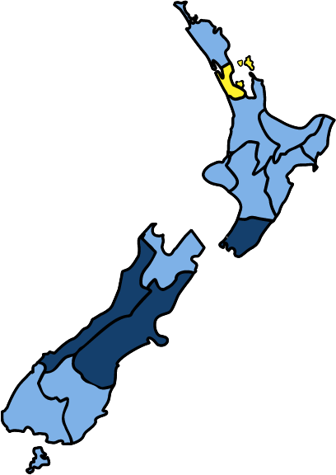
Taken steps to prepare in the last 12 months: Regional differences
Higher than average
Auckland
38%
Average
Below Average
Average
55%
(51%)
Wellington
65%
A higher than average proportion of Wellington, Canterbury, and West Coast residents have taken steps to prepare in the last 12 months. A lower than average proportion of Auckland residents have taken steps to prepare.
West Coast
76%
Canterbury
85%
Christchurch 90%
Note: Percentages are presented that are statistically higher or lower than the national average at the 95% confidence level.

Slide 13
STOP
VERY IMPORTANT NOTE FOR READING THIS REPORT:
Last year’s survey excluded Christchurch residents as it would have been inappropriate to question them at that time about their awareness of and preparedness for disasters. This year’s survey shows that preparedness in Christchurch has changed dramatically since 2010, given residents’ experiences with earthquakes and continued aftershocks.
All 2012 results in this report have been analysed both nationally and after excluding Christchurch residents from the data. This allows direct comparison with the 2011 survey.
Where a result after excluding Christchurch residents differs from the national result, the result after excluding Christchurch residents is displayed alongside the national result in parentheses (as in the previous two charts).

Slide 14
The Christchurch earthquakes remain the main prompt to prepare for a disaster.
What prompted you to prepare?
Disasters that occurred in New Zealand
(73)
Disasters that occurred overseas
(20)
Advertising I saw/heard/read
69% of all respondents specifically said (unprompted) that it was the Christchurch earthquakes that prompted them to take steps to prepare, and 86% of Christchurch residents said this.
(12)
Friends or family
(12)
News/article in the media
(10)
Common sense/ sensible thing to do
(7)
Just want to be prepared
My work/job training makes me aware
(5)
Previous experience of a disaster
Something I have always done
Q11b: What prompted you to do this? Base: Those who have taken steps towards preparing for a disaster in the last 12 months, 2009 (n = 422), 2010 (n = 465), 2011 (n = 726), 2012 (n=731). Note: The top ten responses are shown.
Significantly different from the 2011 result

Slide 15
How prepared is New Zealand in 2012?

Slide 16
You have a good understanding of effects if disaster struck your area
You have the necessary emergency items needed to survive a disaster, e.g. tinned food etc
(80)
(80)
There have been some small decreases this year, particularly for updating survival items, being familiar with information in the Yellow Pages, and having understanding of the disasters that could occur.
You have good understanding of types of disasters that could occur in NZ & the chances of them occurring
You are familiar with the Civil Defence info in the Yellow Pages
(60)
You have an emergency survival plan for your household
(58)
You regularly update your emergency survival items
(50)
You have stored 3L water pp for 3 days for household
(49)
You attend meetings with community groups about disaster planning
None of these
Q10 Which of the following statements apply to you? Base: All Respondents: Benchmark (n= 1001), 2007 (n= 1000), 2008 (n= 1016), 2009 (n=1000), 2010 (n=1000), 2011 (n=1164), 2012 (n=1255).
Significantly different from the 2011 result

Slide 17
Four out of five New Zealand residents (81%) have emergency survival items.
Statistically speaking, this national result (81%) is the same as the 2010 national result (79%), before the Christchurch earthquakes struck.
Further analyses of Christchurch residents’ responses shows that in 2012, the vast majority of Christchurch residents (93%) have emergency survival items. However, among those who live elsewhere in New Zealand, the proportion with survival items has declined slightly (down from 84% in 2011 to 80% this year).
(20)
(80)
Q10. You have necessary emergency items needed to survive a disaster, e.g. tinned food etc
Base: All Respondents: Benchmark (n= 1001), 2007 (n= 1000), 2008 (n= 1016), 2009 (n=1000), 2010 (n=1000), 2011 (n=1164), 2012 (n=1255).
Significantly different from the 2011 result

Slide 18
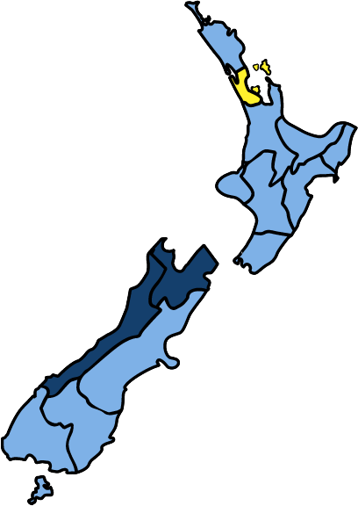
Emergency survival items: Regional differences
Auckland
75%
Higher than average
Average
Below Average
Average
81%
Nelson / Tasman / Marlborough
94%
(80%)
A higher than average proportion of Nelson/Tasman/ Marlborough, and West Coast residents have emergency survival items. A lower than average proportion of Auckland residents have emergency survival items.
West Coast
93%
Christchurch 93%
Note: Percentages are presented that are statistically higher or lower than the national average at the 95% confidence level.

Slide 19
Over one quarter of New Zealand residents (27%) have a plan that includes what to do when away from home.
This figure (27%) remains significantly higher than in 2010, before the Christchurch earthquakes struck. However, again we can see that those living outside Christchurch are less prepared than they were last year. Twenty five percent of those living outside Christchurch have a plan that includes what to do when away from home (down from 30% in 2011).
(42)
Christchurch residents are much more likely than others to have a plan that includes what to do when away from home - 49% have such a plan.
(25)
*Percentages do not add to 100 due to rounding
Q11 Does your survival plan include what to do when you are not at home? Base: All Respondents: Benchmark (n= 1001), 2007 (n= 1000), 2008 (n= 1016), 2009 (n=1000), 2010 (n=1000), 2011 (n=1164), 2012 (n=1255).

Slide 20
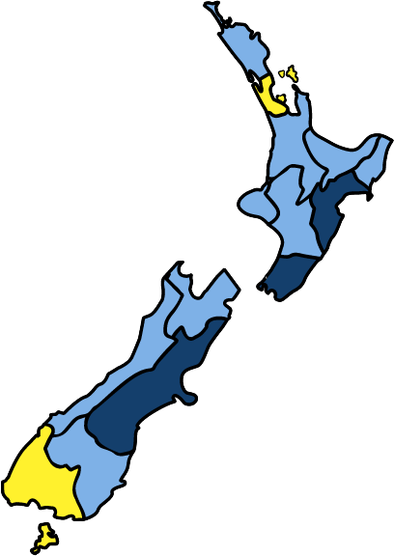
Having a survival plan for when at home: Regional differences
Auckland
46%
Higher than average
Average
Below Average
Average
60%
(58%)
Hawkes Bay
73%
Wellington
71%
A higher than average proportion of Hawkes’ Bay, Wellington, and Canterbury residents have a plan in place when at home. A lower than average proportion of Auckland and Southland residents have a plan in place.
Southland
46%
Canterbury
79%
Christchurch 77%
Note: Percentages are presented that are statistically higher or lower than the national average at the 95% confidence level.

Slide 21
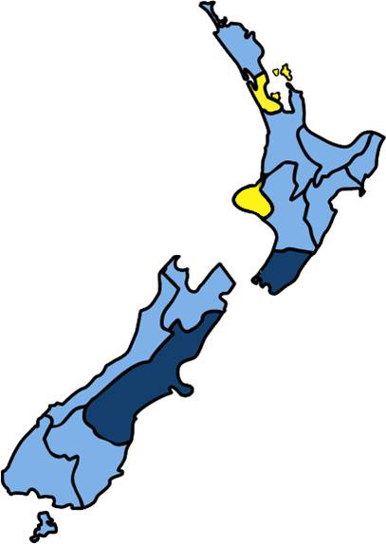
Having a survival plan for when away from home: Regional differences
Auckland
19%
Higher than average
Average
Taranaki
15%
Below Average
Average
27%
(25%)
Wellington
41%
A higher than average proportion of Wellington and Canterbury residents have a plan in place for when they are not at home. A lower than average proportion of Auckland and Taranaki residents have a plan in place for when they are not at home.
Canterbury
44%
Christchurch 49%
Note: Percentages are presented that are statistically higher or lower than the national average at the 95% confidence level.

Slide 22
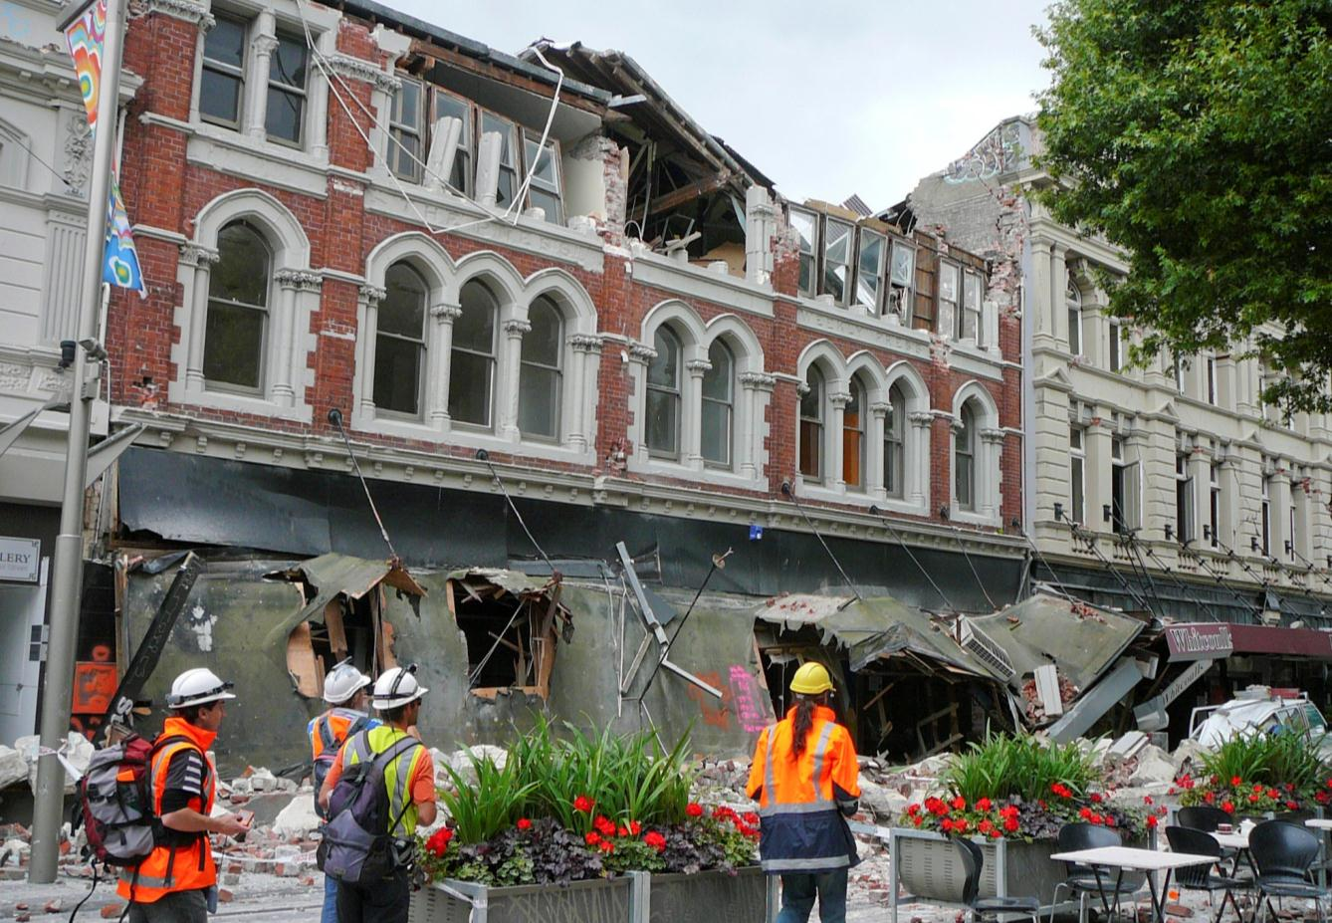
How prepared is New Zealand?
Have an emergency survival plan that includes what to do when not at home
Have emergency items and water
Regularly update emergency survival items
FULLY PREPARED = 16%
18% - 2011 measure
11% - 2010 measure
10% - 2009 measure
10% - 2008 measure
8% - 2007 measure
7% - Benchmark
(14%)
Compared to 2011, fewer people living outside Christchurch are fully prepared (down from 18% to 14% this year).
Christchurch residents are much more likely than others to be fully prepared (40% are fully prepared).

Slide 23
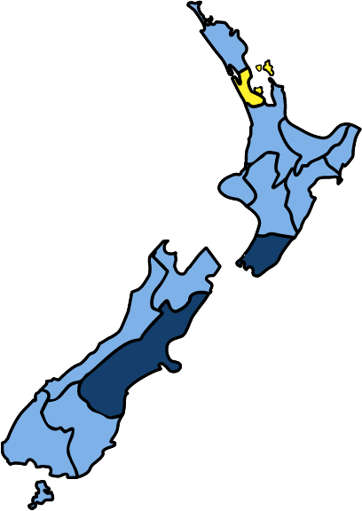
Fully prepared: Regional differences
Auckland
10%
Higher than average
Average
Below Average
Average
16%
(14%)
Wellington
25%
A higher than average proportion of Wellington and Canterbury residents are fully prepared. A lower than average proportion of Auckland residents are fully prepared.
Canterbury
32%
Christchurch 40%
Note: Percentages are presented that are statistically higher or lower than the national average at the 95% confidence level.

Slide 24
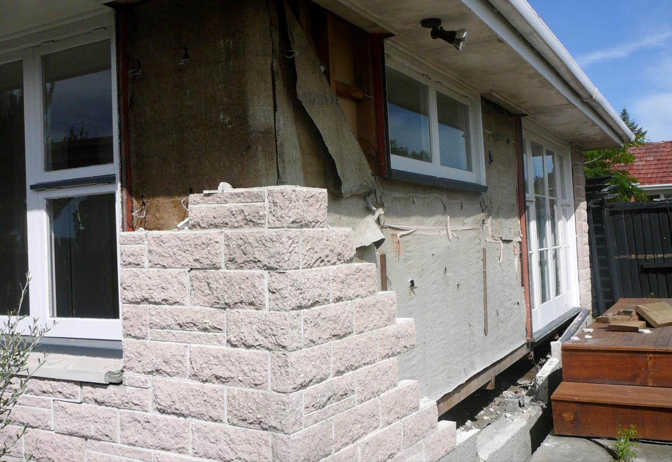
How prepared is New Zealand (when at home)?
Have an emergency survival plan
Have emergency items and water
Regularly update emergency survival items
PREPARED AT HOME = 32%
32% - 2011 measure
24% - 2010 measure
23% - 2009 measure
26% - 2008 measure
24% - 2007 measure
21% - Benchmark
(30%)
When it comes to being prepared at home, there is no significant change in the overall results since 2011.
However, Christchurch residents are much more likely than others to be prepared at home (53% are prepared at home).

Slide 25
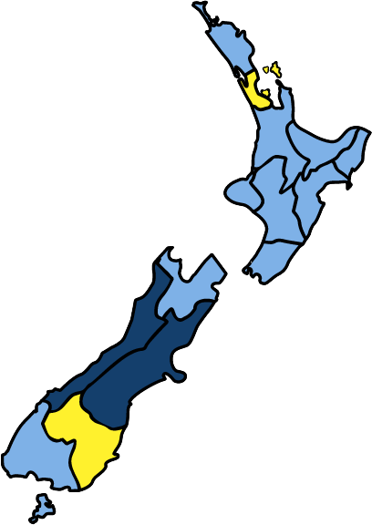
Prepared at home: Regional differences
Auckland
22%
Higher than average
Average
Below Average
Average
32%
(30%)
West Coast
45%
West Coast and Canterbury residents are more likely than average to be prepared at home. Auckland and Otago residents are less likely than average to be prepared at home.
Canterbury
50%
Christchurch 53%
Otago
17%
Note: Percentages are presented that are statistically higher or lower than the national average at the 95% confidence level.

Slide 26
Preparedness continuum.
Bench-mark
2012
2007
2008
2009
2010
2011
Fully prepared
7%
8%
10%
10%
11%
18%
16%
(14%)
Commitment
Have water and survival items
39%
41%
43%
41%
43%
49%
48%
(45%)
Understanding
Have a good understanding of the effects if disaster struck
77%
81%
79%
80%
80%
84%
81%
(80%)
Awareness
Have an understanding of the types of disasters that could occur
83%
82%
82%
81%
79%
82%
78%
Unaware
17%
18%
18%
19%
21%
18%
22%
Significantly different from the 2011 result

Slide 27
Preparedness in Christchurch has increased markedly since residents were last surveyed in 2010.
Christchurch preparedness: Change since 2010
2012
3L of water p/person p/day + survival items
A plan that includes what to do when not at home
2012
2010
2010
76
% 2010
vs
% 2012
% 2010
vs
% 2012
19
Increase from 46% in 2010 to 76% this year.
46
Increase from 19% in 2010 to 49% this year.
49
2012
Prepared at home
Fully prepared
2012
2010
2010
Increase from 31% in 2010 to 53% this year.
Increase from 15% in 2010 to 40% this year.
15
% 2010
vs
% 2012
% 2010
vs
% 2012
31
53
40
Q10 and Q11 Base: Those living in the Christchurch main urban area, 2010 (n=93), 2012 (n=99).

Slide 28
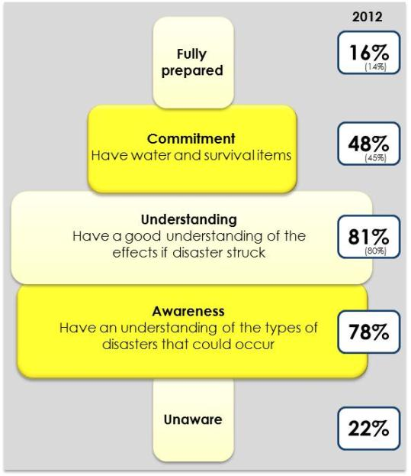
Most at risk when disaster strikes…
Young people, aged 15 to 29 years:
Less likely to be fully prepared (8%) or committed (26%), and to have understanding (70%) or awareness (61%).
More likely to be unaware (39%).
Those who do not identify as NZ European or Māori:
Less likely to be committed (35%), and to have understanding (67%) or awareness (67%).
More likely to be unaware (33%).
Those who have lived in New Zealand for ten years or less:
Less likely to be fully prepared (7%) or committed (32%), and to have understanding (66%) or awareness (66%).
More likely to be unaware (34%).

Slide 29
The main barriers to being prepared remain similar to previous years. Low motivation, perceptions that the likelihood of a disaster is low, and cost remain the most significant barriers.
Barriers to being prepared | BM | ‘07 | ‘08 | ‘09 | ‘10 | ‘11 | ‘12
Haven’t got around to it/no motivation/no time | 40% | 44% | 34% | 25% | 23% | 32% | 31%
Don’t expect it to happen/unlikely to happen | 36% | 29% | 22% | 21% | 17% | 17% | 25%
The cost/don’t have enough money | 8% | 5% | 6% | 10% | 11% | 16% | 18%
Partly prepared/have some emergency supplies | 6% | 15% | 7% | 10% | 3% | 16% | 12%
Complacency | 5% | 3% | 21% | 23% | 23% | 14% | 16%
Not enough information on being prepared | 15% | 6% | 4% | 8% | 9% | 9% | 10%
Priorities/not a high priority | - | - | - | - | 7% | 6% | 6%
Haven’t thought about it/don’t think about disasters | 13% | 10% | 11% | 11% | 8% | 5% | 7%
Haven’t got supplies/shortage of emergency survival items | 2% | * | 1% | 4% | 6% | 4% | 6%
Don’t know what disaster will occur/what to prepare for | 6% | 9% | 2% | 4% | 3% | 4% | 9%
(15%)
(6%)
(8%)
Q6. You said that being prepared for a disaster is important, but you are not well prepared for one. What stops you from being prepared? Base: Those who stated that being very well/ quite well prepared for a disaster was important but said that they were not well prepared for one: Benchmark (n=341), 2007 (n=387), 2008 (n=398), 2009 (n=431), 2010 (n=417), 2011 (n=383), 2012 (n=427). Note: The top ten reasons are shown). *Less than .5%

Slide 30
How effective is the advertising?

Slide 31
Unprompted awareness: There has been a 5%-point increase in unprompted awareness of disaster preparedness advertising.
Percentage of NZers who have seen, heard, or read any advertising about preparing for a disaster and the ratecard value of the TV advertising.
Christchurch residents are just as likely to recall preparedness advertising as those who live elsewhere in New Zealand.
*Ratecard value for TV ads
Advertising recall
Annual ratecard value ($ million)*
Note: The decrease in recall in 2011 was likely due to the fact that the March wave of the quarterly Get Ready Get Thru TV advertising was cancelled following the February earthquake in Christchurch. Furthermore, there was no advertising between July and October 2011, so this year’s ratecard value ($1.3 million) is for the period from 30 October 2011 to 31 June 2012.
Significantly different from the 2011 result
Q15 Have you seen, heard or read recently any advertising about preparing for a disaster? Base: All Respondents: 2007 (n= 1000), 2008 (n= 1016), 2009 (n=1000), 2010 (n=1000), 2011 (n=1164), 2012 (n=1255)

Slide 32
There has been an increase in the proportion of people seeing preparedness advertising on TV, and a decrease in the proportion seeing advertising in newspapers.
Sources of awareness
These changes may be due to the following:
MCDEM ran their usual wave of advertising this quarter (the March 2011 wave of advertising was cancelled following the Christchurch earthquake).
There has likely been a decrease in newspaper retail advertising for emergency supplies (eg, Mitre 10, Foodstuffs) compared to mid-2011, the period immediately following the earthquakes.
(18)
Awareness is higher in Christchurch for newspaper (33%) and radio (28%) advertising.
(15)
Q16 Where did you see, hear or read the ads? Base: Those respondents who stated that they have seen, heard or read advertising about preparing for a disaster, 2007 (n=651), 2008 (n=543), 2009 (n=549), 2010 (n=659), 2011 (n=713), 2012 (n=797) Note: Responses 2% and below not shown.
Significantly different from the 2011 result

Slide 33
Prompted recognition: 69% of New Zealand residents specifically recall the Get Ready Get Thru television advertising.
Prompted recall has increased 6%-points since 2011. There is no significant difference in prompted recall between Christchurch residents and those living elsewhere.
*Ratecard value for TV ads
Norm
(52%)
Recall lower among:
Those for whom English is not a first language (50%, cf. 72% of others)
Those who have been in NZ for 5 years or less (42%, cf. 71% of others)
Those who identify with an Asian ethnic group (48%, cf. 71% of others)
Those over 60 years of age (53%, cf. 73% who are younger)
Those with a HH income under $40k (60%, cf. 71% of others)
Prompted TV advertising recall
Annual ratecard value ($ million)*
Q18. Have you seen any television advertisements for Civil Defence presented by Peter Elliot? The ads featured emergency services, public transport, and hospitals. The ads show what services may not be there to help you in an emergency and what you need to do to help you survive a disaster. Peter also directs us to the Yellow Pages for further information as well as telling us to go to the “Get Ready, Get Thru” website. Base: All Respondents: 2007 (n= 1000), 2008 (n= 1016), 2009 (n=1000), 2010 (n=1000), 2011 (n=1164), 2012 (n=1255).
Significantly different from the 2011 result

Slide 34
More people think the ads contain new information this wave, and find the ads relevant and believable.
% agree
98
97
98
99
98
99
You understood the ad’s message
97
96
96
96
96
98
The points made were believable
91
92
94
92
89
95
The points made were relevant
92
92
95
92
94
96
The information was helpful
81
80
85
79
77
81
You enjoyed watching the ads
64
53
70
57
58
65
The ads contained new information
(66)
20
16
22
18
20
22
You are getting fed up seeing them
Don’t know
Strongly disagree
Slightly disagree
Slightly agree
Strongly agree
Significantly different from the 2011 result
Q19 Thinking about these adverts for the Ministry of Civil Defence and Emergency Management, please tell me whether you strongly agree, slightly agree, slightly disagree or strongly disagree with each of these statements? Base: Those respondents who stated that they had seen the Civil Defence TV advertising, 2007 (n=631), 2008 (n=418), 2009 (n=608), 2010 (n=654), 2011 (n=710), 2012 (n=830).

Slide 35
Action taken as a result of seeing the ads
Most people who have seen the ads (88%) have done something or thought about doing something as a result (up from 81% in 2011 and 2010).
(48)
Three quarters of New Zealand residents who have seen the ads (75%) have gone beyond thinking about preparing, and have taken at least one of the following actions as a result: talked to family/friends, made a survival kit, made a survival plan, visited the Get Ready Get Thru website, or visited other disaster preparation websites.
(9)
Significantly different from the 2011 result
Q20 What if anything have you done as a result of seeing the ads? Have you…
Base: Those respondents who stated that they had seen the Civil Defence TV advertising, 2007 (n=631), 2008 (n=518), 2009 (n=608), 2010 (n=654), 2011 (n=710), 2012 (n=830).

Slide 36
The tagline has become more familiar throughout the campaign.
More than half of New Zealand residents (59%) recall the ‘Get Ready, Get Thru’ tagline.
The tagline is particularly familiar to:
young people aged 15 to 29 (75%, cf. 53% of those aged 30 years or over)
people from middle (65%, $60-$100k) and higher income households (66%, over $100k, cf. 46%, $40k or less)
(58%)
Prompted recall of Get Ready Get Thru tagline
Significantly different from the 2011 result
Q21. Before I mentioned it earlier, had you previously heard of the tag line “Get Ready, Get Thru”?
Base: All Respondents: 2007 (n= 1000), 2008 (n= 1016), 2009 (n=1000), 2010 (n=1000), 2011 (n=1164), 2012 (n=1255)

Slide 37
Half of New Zealand residents (49%) are aware of the getthru.govt.nz website.
Awareness of the website is lower among:
those aged 40 years or over (41%, cf. 59% of those under 40)
those who have lived in New Zealand for five years or less (34%, cf. 50% of those who have lived in NZ longer or were born in NZ)
Prompted recall of getthru.govt.nz
(48%)
Significantly different from the 2011 result
Q22 And had you also previously heard of the website ‘getthru.govt.nz’?
Base: All Respondents: 2007 (n= 1000), 2008 (n= 1016), 2009 (n=1000), 2010 (n=1000), 2011 (n=1164), 2012 (n=1255)

Slide 38
Other than ‘be prepared’ the main messages taken from the ads are ‘telling us how to prepare’, ‘make sure you have supplies’, and ‘disasters can strike at any time’.
Advertising message take-out
(81)
(24)
Q17. What do you think the ads were trying to tell you? Base: Those respondents who stated that they have seen or heard advertising about preparing for a disaster, 2009 (n=549), 2010 (n=659), 2011 (n=713), 2012 (n=797). Note: The top ten messages are shown.
Significantly different from the 2011 result

Slide 39
There have been decreases in awareness of non-advertising disaster preparedness messages in some mainstream media sources, such as on TV and in daily newspapers.
Sources of non-advertising preparedness messages
(34)
(8)
(7)
(9)
There was a significant increase in awareness of such messages in the months following the Christchurch earthquakes. Non-advertising preparedness messages in the media have probably reduced since mid-2011.
(16)
Q22a Other than in any advertising, where else have you seen or heard other messages or information about disasters? Base: All Respondents, 2009 (n = 1000), 2010 (n=1000), 2011 (n=1164), 2012 (n=1255) Note: The top ten sources are shown.
Significantly different from the 2011 result

Slide 40
Attitudes and awareness

Slide 41
Attitudes toward disasters
% agree
Benchmark
2007
2008
2009
2010
2011
2012
61
67
71
76
64
74
73
In a disaster there will be someone there to help you
Last year, following media coverage of responses to the Christchurch earthquakes, the results suggested greater confidence that someone will be there to help. This has carried through into 2012.
Benchmark
2007
2008
2009
2010
2011
2012
65
70
75
77
65
75
75
In a disaster, emergency services would be there to help you
(74)
Benchmark
2007
2008
2009
2010
2011
2012
25
31
30
38
36
28
36
There will always be adequate warning before disaster hits
Relative to last year there has been a small decrease in the proportion of people who appreciate that a disaster could strike at any time.
(38)
Benchmark
2007
2008
2009
2010
2011
2012
94
97
98
98
99
98
98
Christchurch residents are much more likely to appreciate that there will not often be adequate warning before disaster hits (84% disagree with this statement, compared to just 60% who live elsewhere in New Zealand).
It’s my responsibility to look after myself & family in a disaster
Significantly different from the 2011 result
Don’t know
Strongly disagree
Slightly disagree
Slightly agree
Strongly agree
Q2 On a scale of strongly agree, slightly agree, slightly disagree and strongly disagree, how much do you agree or disagree with the following statements? Base: All Respondents: Benchmark (n=1001), 2007 (n= 1000), 2008 (n=1016), 2009 (n=1000), 2010 (n=1000), 2011 (n=1164), 2012 (n=1255)

Slide 42
The importance of preparing for a disaster, and self-rated preparedness, remain consistent with last year.
% important/ prepared
% of those who say it’s important who also say they are very or quite prepared
94
52
93
52
2006 – 54%
2007 – 54%
95
54
2008 – 56%
2009 – 52%
95
50
2010 – 54%
2011 – 62%
95
52
2012 – 60%
96
60
Christchurch residents are more likely than others to say they are prepared - 86% say they are quite or very prepared, compared to 56% who live elsewhere.
96
59
(56)
Not at all important/ prepared
Not that important/ prepared
Quite important/ prepared
Very important/ prepared
Q3 How important is it that you are prepared for a disaster? Is it… Q5. How well prepared for a disaster do you feel you are? Do you feel you are… Base: All Respondents: Benchmark (n=1001), 2007 (n= 1000), 2008 (n= 1016), 2009 (n=1000), 2010 (n=1000), 2011 (n=1164), 2012 (n=1255).
Significantly different from the 2011 result

Slide 43
Awareness remains high that earthquakes can occur in New Zealand.
Possible disasters in New Zealand in your lifetime
(98)
Awareness of tsunami increased in 2010 and has remained high.
(55)
(46)
Fewer people mention hurricanes, cyclones and storms this year, although Christchurch residents are much more likely than average to mention these (49%, cf. 38% on average)
(37)
Q1 First I’d like to ask about the types of major disasters that could happen in New Zealand. What types of disasters can you think of that could happen in New Zealand in your lifetime? Base: All Respondents: Benchmark (n= 1001), 2007 (n= 1000), 2008 (n= 1016), 2009 (n=1000), 2010 (n=1000), 2011 (n=1164), 2012 (n=1255). Note: Only the top six disasters for 2012 are shown.
Significantly different from the 2011 result

Slide 44
There is now greater awareness that a wide range of services may help following a disaster.
Who would be able to help following a disaster?
(86)
(84)
(80)
(76)
Christchurch residents in particular are likely to recognise that their neighbours (97%), the police (89%), the ambulance service (86%), hospitals (86%), and the army (86%) may help following a disaster.
(68)
(71)
(50)
Q7. Now I’d like you to imagine that there has been a disaster in the town, city or rural area where you live. What groups or individuals do you think would be able to help you following a disaster? Base: All Respondents: 2007 (n= 1000), 2008 (n=1016), 2009 (n=1000), 2010 (n=1000), 2011 (n=1164), 2012 (n=1255)
Significantly different from the 2011 result

Slide 45
Throughout the course of the research more New Zealand residents have become aware that mobile phone services may be disrupted following a disaster.
Which services could be disrupted?
(93)
More people are aware of potential gas service disruptions this wave (up from 78% in 2011 to 85% this wave).
Christchurch residents are particularly likely to say that sewerage (98%) and mobile phone services (93%) may be disrupted.
(89)
(86)
(73)
Q8 Still imagining there had been a disaster, some of the normal services may not be available. Which of the following household utilities or infrastructure services do you think could be disrupted? Base: All Respondents: 2007 (n= 1000), 2008 (n=1016), 2009 (n=1000), 2010 (n=1000), 2011 (n=1164), 2012 (n=1255).
Significantly different from the 2011 result

Slide 46
The most common places people will look for preparedness information prior to a disaster are the Yellow Pages, the internet, and a Civil Defence website.
Finding information before a disaster.
(50)
(41)
(29)
(11)
(9)
Q12 Before a disaster, where can you get information about how to prepare for a disaster?
Base: All Respondents: Benchmark (n= 1001), 2007 (n= 1000), 2008 (n= 1016), 2009 (n=1000), 2010 (n=1000), 2011 (n=1164), 2012 (n=1255). Note: The top eight results for 2012 are shown.
Significantly different from the 2011 result

Slide 47
Most New Zealand residents mention that to prepare for disaster they need a supply of survival items, and food and water. Under half mention that they need a survival plan.
How to prepare for a disaster (unprompted)
(82)
(74)
(45)
Significantly different from the 2011 result
Q6a What things do you think households should do to prepare for a disaster?
Base: All Respondents: Benchmark 2009 (n=1000), 2010 (n=1000), 2011 (n=1164), 2012 (n=1255).

Slide 48
Action

Slide 49
An increasing proportion of New Zealand residents say they would alert or check on family and friends during or following a disaster.
Actions to take during and after an Earthquake
(54)
Christchurch residents are more likely than others to say ‘drop, cover, and hold’(18%, cf. 9% who live elsewhere in New Zealand).
The increase in the proportion of people saying ‘go outside/into the open’ needs to be addressed in campaign messaging.
(12)
Q9b Now imagine that there is a strong earthquake in your area, what actions should people take during and immediately following a strong earthquake? Base: All Respondents: Benchmark (n= 1001), 2007 (n= 1000), 2008 (n= 1016), 2009 (n=1000), 2010 (n=1000), 2011 (n=1164), 2012 (n=1255). Note: The top eight results for 2012 shown.
Significantly different from the 2011 result

Slide 50
Over the last few years an increasing number of New Zealand residents have been saying that you should move to higher ground in the event of a tsunami warning.
Actions to take in the event of a Tsunami warning
(91)
(32)
(18)
(14)
(4)
Q9a Now imagine that a tsunami warning has been issued, what actions should people take when a tsunami warning has been issued? Base: All Respondents: Benchmark (n= 1001), 2007 (n= 1000), 2008 (n= 1016), 2009 (n=1000), 2010 (n=1000), 2011 (n=1164), 2012 (n=1255). Note: The top eight results for 2012 are shown.
Significantly different from the 2011 result

Slide 51
Conclusions

Slide 52
Conclusions
The Christchurch earthquakes gave New Zealand residents a better understanding of what can happen in an emergency, and showed them that they may need to survive on their own for an extended period following a disaster.
The earthquakes created a sense of urgency, and many people were prompted to take action. As a result, New Zealand’s preparedness increased substantially in 2010.
Preparedness this year is still higher than it was in 2010, but the results show there have been some small declines in preparedness among those living outside of Christchurch.
Sixteen percent of all New Zealand residents are fully prepared for an emergency.
Half (48%) have both water and survival items.
The majority are aware of the types of disasters that could occur (78%) and have understanding of the effects if one struck (81%).

Slide 53
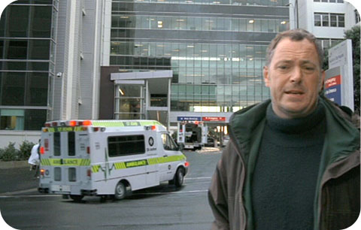
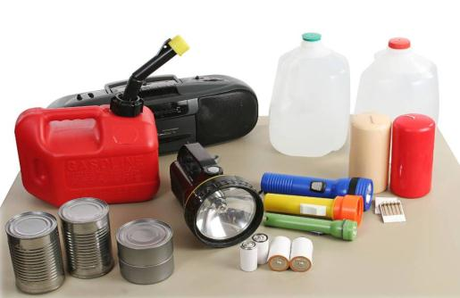
Conclusions (continued)
Awareness of the Civil Defence TV advertising has increased since last year. This was expected given that the March 2011 Get Ready Get Thru advertising was cancelled following the February earthquake.
The ads prompt people to think about preparing or to take action:
Most people who have seen the ads (88%) ads have done something or thought about doing something as a result (up from 81% in 2011 and 2010).
The tag line ‘Get Ready, Get Thru’ is becoming increasingly familiar to people - 59% now recall the tagline (up from 49% in 2011).
Half of all New Zealand residents (49%) are now aware of the getthru.govt.nz website (up from 40% in 2011).

Slide 54
Challenges
The impact of the Christchurch earthquakes on New Zealand residents’ appears to have lessened. Preparedness may lessen further unless people can be prompted to maintain and increase their preparedness.
The challenges going forward are:
1. Maintaining preparedness - make sure those who are prepared stay prepared.
They can do this by
Checking/refreshing their emergency supplies (some people have not done this). For example – at daylight savings check your emergency supplies.
Recording (writing down) their plan for survival, so it doesn’t get forgotten.
2. Encouraging action among those who are not yet fully prepared.
Most people already believe it’s important to prepare, but many are not motivated to prepare, see it as too expensive, or believe that a disaster is unlikely to happen.
To address these barriers the campaign should encourage people to take action now, and should seek to maintain the sense of urgency that developed following the earthquakes.
The website should continue to be referred to as the source for further information.
3. Raising awareness among those most at risk.
Given the kinds of people most at risk (young people, ethnic minorities, and immigrant groups), this can’t be addressed solely though a mass marketing campaign. Further effective engagement with targetted communities and local organisations (eg, churches, student unions) will help to increase awareness among those groups most at risk.
Those at risk need to know what could happen if disaster strikes, and how to prepare.

Slide 55
Regional Analyses

Slide 56
Regional Analyses
The pages that follow list the statistically significant differences between the overall (average) results for NZ and responses provided by people living in the various regions of the country.
The graph below provides the sample size for each region. The results have been weighted to 2006 Census figures to represent the proportion of New Zealanders aged 15+ within each region.
Number of interviews carried out in each region
Please note: Caution must be used in interpreting figures prior to 2011, due to small base sizes within some regions.
Source: Survey call data (total number of interviews = 1,255)

Slide 57
Auckland
Benchmark
2007
2008
2009
2010
2011
2012
Fully prepared
4%
4%
3%
7%
9%
11%
10%
Prepared at home
15%
15%
14%
20%
18%
21%
22%
Has a plan
38%
39%
35%
40%
40%
53%
46%
Has survival items
83%
83%
67%
74%
75%
79%
75%
Preparedness
Aucklanders are less likely than the national average to be fully prepared for a disaster (only 10% are fully prepared, cf. national average of 16%). They are also less likely than average to be prepared at home (22% cf. 32% national average).
In Auckland, preparedness levels are significantly lower than average in seven of the preparedness diagnostics, including:
You have a good understanding of the types of disasters that could occur in New Zealand, and the chances of them occurring (70% cf. 78% national average)
You have a good understanding of what the effects would be if a disaster struck in your area (73% cf. 81% national average)
You are familiar with the Civil Defence information in the Yellow Pages (48% cf. 61% national average)
You have an emergency survival plan for your household (46% cf. 60% national average)
You have stored at least 3 litres of water per person for 3 days for each member of your household (38% cf. 51% national average)
You have the necessary emergency items needed to survive a disaster (75% cf. 81% national average)
You regularly update your emergency survival items (45% cf. 52% national average).
Sample size = 278

Slide 58
Auckland (continued)
Preparedness (continued)
Aucklanders are less likely than average to say that they feel either ‘very well prepared’ or ‘quite well prepared’ for a disaster (only 43% cf. 59% national average).
They are also less likely than average to have an emergency plan that includes while they are at home and away from home (only 19% cf. 27% national average).
In the last 12 months, significantly fewer Aucklanders (when compared to average) have taken steps to prepare themselves or their household for a disaster (only 38% cf. 55% national average).
Advertising and information
Aucklanders are less likely than average to recall seeing, hearing, or reading any advertising about preparing for a disaster (only 56% cf. 65% national average). Of the Aucklanders who have seen an advertisement, significantly fewer than average recall having seen something in the newspapers (10% cf. 20% national average).
They are also less likely than average to recall seeing a Civil Defence TV advertisement (62% cf. 69% on average). Of the Aucklanders who have seen one of the TV advertisements, significantly fewer than average said the ad prompted them to make or update their survival kit (38% cf. 50% national average).
Source: Survey call data (total number of interviews = 1,000)
Sample size = 278

Slide 59
Auckland (continued)
Disaster awareness
Auckland residents are more likely than average to think that a volcanic eruption can happen in NZ in their lifetime (53% cf. 45% national average), and they are less likely than average to think a flood can happen (47% cf. 56% national average).
They are more likely than average to agree that there will always be adequate warning before a disaster strikes (44% cf. 36% national average).
They are also more likely than average to say that gas services (89% cf. 85% national average) could be disrupted following a disaster.
Aucklanders are less likely than average to say that they can get information about how to prepare for a disaster from their local or regional council (17% cf. 28% national average) and from Civil Defence (unspecified) (6% cf. 11% national average).
Aucklanders are also less likely than average to say that in the event of a tsunami, people should move to higher ground or away from danger (85% cf. 90% national average), and they are less likely than average to say that in the event of an earthquake, people should alert or check on family, friends and neighbours (48% cf. 55% national average).
Source: Survey call data (total number of interviews = 1,000)
Sample size = 278

Slide 60
Canterbury
Benchmark
2007
2008
2009
2010
2011
2012
Fully prepared
5%
10%
8%
11%
13%
NA
32%
*Note: Up until 2010 the results for the Canterbury region were combined with the results for the West Coast region.
Prepared at home
19%
24%
40%
25%
27%
NA
50%
Has a plan
52%
52%
62%
54%
51%
NA
79%
Has survival items
79%
87%
89%
83%
80%
NA
88%
Preparedness
The proportion of Canterbury residents who are fully prepared for a disaster is significantly higher than average (32% cf. 16% national average), and compared to 2010, has significantly increased (from 13% in 2010 to 32% this year).
Similarly, the proportion that are prepared at home is significantly higher than average (50% cf. 32% national average), and compared to 2010, has significantly increased (from 27% in 2010 to 50% this year).
In Canterbury, preparedness levels are significantly higher than average for the following four preparedness diagnostics:
You have a good understanding of what the effects would be if a disaster struck in your area (90% cf. 81% national average)
You have an emergency survival plan for your household (79% cf. 60% national average) – note that this has significantly increased from 2010 when only 51% had a plan
You regularly update your emergency survival items (69% cf. 52% national average)
You have stored at least 3 litres of water per person for 3 days for each member in your household (73% cf. 51% national average).
Significantly different from the 2010 result
Sample size = 131

Slide 61
Canterbury (continued)
Preparedness (continued)
The proportion of Canterbury residents who have a plan for when they are at home and away from home is significantly higher than average (44% cf. 27% national average).
The proportion of Canterbury residents who have taken steps in the last 12 months to prepare themselves or their household for a disaster is significantly higher than average (85% cf. 55% national average). Of these residents that have taken action, a higher proportion than average said that the Christchurch earthquake prompted them to take these steps (89% cf. 69% national average). Conversely, a smaller proportion than average said that disasters from overseas prompted them to take action (10% cf. 18% national average).
Canterbury residents are more likely than average to say that they feel either ‘very well prepared’ or ‘quite well prepared’ for a disaster (82% cf. 59% national average).
Advertising and information
Canterbury residents who have seen a Civil Defence TV advertisement are significantly more likely than average to say that the advertisement prompted them to make or update their survival kit (66% cf. 50% national average).
Disaster awareness
Residents in the Canterbury region are less likely than average to agree that there will always be adequate warning before a disaster hits (18% cf. 36% national average).
Sample size = 131

Slide 62
Canterbury (continued)
Disaster awareness (continued)
Canterbury residents are more likely than average to say that the following groups or individuals will be there to help them following a disaster:
Neighbours (96% cf. 87% national average)
Ambulances (86% cf. 77% national average)
Hospitals (83% cf. 72% national average)
Army (85% cf. 69% national average).
Residents from the Canterbury region are more likely than average to think that the following household utilities or infrastructure services could be disrupted following a disaster:
Water supplies (97% cf. 91% national average)
Sewerage (98% cf. 90% national average)
Mobile phone services (86% cf. 75% national average).
In addition to the above, they are less likely than average to think that land line telephones could be disrupted (82% cf. 92% national average).
Residents from the Canterbury region are more likely than average to think that in the event of a tsunami, people should move inland (28% cf. 19% national average), and that in the event of an earthquake, people should ‘drop, cover and hold’ (18% cf. 9% national average).
Sample size = 131

Slide 63
Wellington
Benchmark
2007
2008
2009
2010
2011
2012
Fully prepared
18%
16%
24%
14%
18%
33%
25%
Prepared at home
35%
37%
41%
26%
34%
51%
40%
Has a plan
59%
67%
63%
49%
57%
79%
71%
Has survival items
76%
77%
82%
71%
86%
88%
83%
Preparedness
Overall, a quarter (25%) of Wellington residents are fully prepared for a disaster. This is higher than the national average of 16%.
The proportion of Wellington residents who have taken steps in the past 12 months to prepare for a disaster is higher than average (65% cf. 55% national average).
Similarly, the proportion of Wellington residents who have a survival plan for when they are at home and away from home is significantly higher than average (41% cf. 27% national average).
In Wellington, preparedness levels are significantly higher than average in two of the preparedness diagnostics, including:
You have an emergency survival plan for your household (71% cf. 60% national average)
You have stored at least 3 litres of water per person for 3 days for each member in your household (67% cf. 51% national average).
Sample size = 109

Slide 64
Wellington (continued)
Advertising and information
Among Wellington residents who have seen a Civil Defence TV advertisement, significantly fewer than average said the advertisement prompted them to ‘think about preparing for a disaster’ (63% cf. 75% national average).
Wellington residents are more likely than average to state that they saw or heard non-advertising information about disasters via the internet (19% cf. 10% national average) or at work/through workmates (12% cf. 6% national average). They are less likely than average to state that they saw or heard non-advertising information about disasters on the television (23% cf. 33% national average).
Disaster awareness
Wellington residents are more likely than average to say that a fire could happen in NZ in their lifetime (35% cf. 24% national average), and they are less likely to say a volcanic eruption could happen (33% cf. 45% national average).
Wellington residents are less likely than average to think that in a disaster, emergency services will be there to help them (64% cf. 75% national average), and that there will be adequate warning before a disaster hits (24% cf. 36% national average).
Wellington residents are more likely than average to say that in the event of a strong earthquake, people should check emergency survival items (19% cf. 12% national average), and turn off all electricity, power and gas immediately following the disaster (23% cf. 11% national average).
Residents from Wellington are less likely than average to say information about how to prepare for a disaster can be obtained via the police (2% cf. 8% national average).
Sample size = 109

Slide 65
Waikato
Benchmark
2007
2008
2009
2010
2011
2012
Fully prepared
9%
6%
7%
11%
12%
12%
8%
Prepared at home
21%
22%
19%
18%
21%
34%
29%
Has a plan
44%
46%
45%
50%
47%
57%
52%
Has survival items
68%
91%
81%
75%
80%
86%
77%
Preparedness
Preparedness levels among Waikato residents are statistically similar to the national average:
Just under one in ten are fully prepared (8%)
Just under a third are prepared at home (29%).
Similarly, preparedness levels are on par with the national average for the following preparedness diagnostics:
83% have a good understanding of what the effects would be if a disaster struck in their area
79% said they have a good understanding of the types of disasters that could occur in New Zealand, and the chances of them occurring
77% have the necessary emergency items needed to survive a disaster
57% are familiar with the Civil Defence information in the Yellow Pages
52% have an emergency survival plan for their household
44% regularly update their emergency survival items
43% have stored at least 3 litres of water per person for 3 days, for each member in their household
6% attend meetings with community groups about disaster planning.
Sample size = 81

Slide 66
Waikato (continued)
Preparedness (continued)
Waikato residents are more likely than average to say that they have not taken steps in the past 12 months to prepare for a disaster (57% cf. 45% national average).
Advertising and information
The proportion of Waikato residents that have seen, heard, or read advertising about preparing for a disaster is generally consistent with the national average at 71%.
Similar to the national average, three quarters (74%) of Waikato residents recall having seen a Civil Defence TV advertisement. Of those who have seen a Civil Defence TV advertisement, the proportion of Waikato residents who said that the advertisements prompted them to think about preparing for disasters is significantly higher than average (88% cf. 75% national average).
Disaster awareness
Waikato residents are more likely than average to think that a flood could occur in NZ during their lifetime (67% cf. 56% national average), and are less likely than average to think that a tsunami could occur (60% cf. 72% national average).
Among Waikato residents, awareness of where to find information about preparing for a disaster is generally consistent with the national average:
48% mentioned the Yellow Pages
44% mentioned the internet in general
37% mentioned their local or regional council
36% mentioned the Civil Defence website
17% mentioned Civil Defence (non-specific).
Sample size = 81

Slide 67
Bay of Plenty
Benchmark
2007
2008
2009
2010
2011
2012
Fully prepared
8%
2%
13%
15%
12%
12%
17%
Prepared at home
16%
16%
34%
28%
22%
34%
37%
Has a plan
43%
42%
57%
54%
47%
66%
63%
Has survival items
67%
82%
90%
78%
81%
87%
81%
Preparedness
Preparedness levels among the Bay of Plenty residents statistically similar to the national average:
17% are fully prepared; 37% are prepared at home
Just under two thirds (63%) have an emergency plan and 81% have survival items.
Preparedness levels among Bay of Plenty residents are significantly higher than average for the preparedness diagnostic ‘you are familiar with the Civil Defence information in the Yellow Pages’ (75% cf. 61% national average).
One in two residents (55%) from the Bay of Plenty have taken steps in the last 12 months to prepare themselves or their households for a disaster. Of these residents, the proportion that said that a disaster in NZ prompted them to take action is significantly lower than average (only 57% cf. 75% national average).
Sample size = 71

Slide 68
Bay of Plenty (continued)
Advertising and information
The proportion of residents from the Bay of Plenty that have seen, heard, or read advertising about preparing for a disaster is generally consistent with the national average at 75%.
Just under three quarters of Bay of Plenty residents (73%) have seen a Civil Defence TV advertisement, 57% have previously heard of the tag line ‘Get Ready, Get Thru’, and 48% have previously heard of the website ‘getthru.govt.nz’, all of which are consistent with the national average.
Disaster awareness
Residents from the Bay of Plenty are more likely than average to think a volcanic eruption could happen in NZ in their lifetime (61% cf. 45% national average).
They are also more likely than average to think that access to medical and health services could be disrupted following a disaster (98% cf. 90% national average).
Among Bay of Plenty residents, awareness of where to find information about preparing for a disaster is generally consistent with the national average:
56% mentioned the Yellow Pages
42% mentioned the internet in general
36% mentioned the Civil Defence website
29% mentioned their local or regional council
9% mentioned Civil Defence (un-specified).
Sample size = 71

Slide 69
northland
Benchmark
2007
2008
2009
2010
2011
2012
Fully prepared
1%
7%
10%
6%
6%
12%
12%
Prepared at home
13%
33%
24%
25%
34%
25%
37%
Has a plan
37%
51%
42%
56%
55%
45%
62%
Has survival items
87%
91%
93%
80%
74%
84%
79%
Preparedness
Just over a third of Northland residents are prepared at home (37%).
Eight in ten Northland residents have an emergency supply of essential items (79%).
Preparedness levels among Northland residents are on par with the national average for the following preparedness diagnostics;
87% said they have a good understanding of the types of disasters that could occur in New Zealand, and the chances of them occurring
82% have a good understanding of what the effects would be if a disaster struck in their area
67% are familiar with the Civil Defence information in the Yellow Pages
62% have an emergency survival plan for their household
53% have stored at least 3 litres of water per person for 3 days, for each member in their household
52% regularly update their emergency survival items
12% attend meetings with community groups about disaster planning.
One in two Northland residents (48%) have taken steps in the last 12 months to prepare themselves or their household for a disaster. Of these residents, a significantly higher proportion than average said that a disaster overseas prompted them to take these steps (35% cf. 18% national average), and significantly fewer said a disaster in NZ prompted them (52% cf. 75% national average).
Sample size = 63

Slide 70
Northland (continued)
Advertising and information
The proportion of Northland residents who have seen, heard, or read any general advertising about preparing for a disaster is relatively consistent with the national average at 65%.
Similarly, the proportions of Northland residents who have seen a Civil Defence TV advertisement (69%), who have previously heard of ‘Get Ready, Get Thru’ (49%), and who have previously heard of the website ‘getthru.govt.nz’ (48%) are on par with national results.
Disaster awareness
Northland residents are more likely than average to think they can get information about how to prepare for a disaster from the police (22% cf. 8% national average).
Residents from Northland are more likely than average to think that there will always be adequate warning before a disaster hits (54% cf. 36% national average).
They are also more likely than average to think that in the event of a tsunami warning, people should move to higher ground (98% cf. 90%), and that in the event of an earthquake, people should go outside or out into the open (29% cf. 18% national average).
Northland residents are less likely than average to think that in the event of a disaster in their area, the Army will be there to help them (55% cf. 69% national average).
They are also less likely than average to think the following household utilities or infrastructure services could be disrupted if a disaster took place:
Water (79% cf. 91% national average)
Gas (74% cf. 85% national average).
Sample size = 63

Slide 71
Taranaki
Benchmark
2007
2008
2009
2010
2011
2012
Fully prepared
Sample size too small
Sample size too small
Sample size too small
Sample size too small
Sample size too small
14%
11%
Prepared at home
22%
25%
Has a plan
47%
39%
57%
43%
36%
62%
56%
Has survival items
81%
84%
90%
81%
68%
76%
84%
Preparedness
Preparedness levels among Taranaki residents are statistically similar to the national average:
Just over one in ten are fully prepared (11%)
A quarter are prepared at home (25%)
One in two have an emergency plan (56%)
Four in five have emergency survival items (84%).
In Taranaki, preparedness levels are significantly higher than average for the preparedness diagnostic ‘you have a good understanding of the types of disasters that could occur in New Zealand, and the chances of them occurring’ (89% cf. 78% national average).
When compared to average, significantly fewer Taranaki residents said that they have a plan for when they are at home and away from home (15% cf. 27% national average).
Sample size = 67

Slide 72
Taranaki (continued)
Advertising and information
Among Taranaki residents that have seen, heard, or read some advertising about preparing for a disaster, significantly more than average said they heard the advertisement on the radio (35% cf. 16% national average).
Just under three quarters of Taranaki residents (72%) recall seeing a Civil Defence TV advertisement. Of these residents, a significantly higher than average proportion said that the advertisement didn’t prompt them to do anything (31% cf. 12% national average).
Disaster awareness
Taranaki residents are more likely than average to say that a volcanic eruption could occur in NZ in their lifetime (74% cf. 45% national average), and that a hurricane, cyclone, or storm could occur (57% cf. 38% national average). They are less likely than average to say that a fire could occur (only 12% cf. 24% national average).
Taranaki residents are more likely than average to say that they can get information about how to prepare for a disaster from their local or regional council (44% cf. 28% national average) or the police (19% cf. 8% national average). They are less likely to say information can be obtained via the internet (20% cf. 42% national average).
Sample size = 67

Slide 73
Manawatu
Benchmark
2007
2008
2009
2010
2011
2012
Fully prepared
6%
16%
16%
15%
7%
20%
15%
Prepared at home
28%
34%
30%
33%
22%
36%
42%
Has a plan
52%
63%
55%
65%
50%
67%
67%
Has survival items
85%
97%
76%
94%
82%
80%
81%
Preparedness
Three quarters of Manawatu residents (75%) said that they feel either ‘very well prepared’ or ‘quite well prepared’ for a disaster. This is significantly higher than the national average where only 59% said this.
Two thirds of Manawatu residents (65%) have taken steps in the last 12 months to prepare themselves or their household for a disaster. While this is on par with the national average, significantly fewer residents (when compared to average) said that these steps were prompted by the Christchurch earthquake (50% cf. 69% national average).
Preparedness levels among Manawatu residents are on par with the national average for the following preparedness diagnostics:
87% said they have a good understanding of the types of disasters that could occur in New Zealand, and the chances of them occurring
83% have a good understanding of what the effects would be if a disaster struck in their area
81% have the necessary emergency items needed to survive a disaster
71% are familiar with the Civil Defence information in the Yellow Pages
67% have an emergency survival plan for their household
62% regularly update their emergency survival items
58% have stored at least 3 litres of water per person for 3 days, for each member in their household
8% attend meetings with community groups about disaster planning.
Sample size = 63

Slide 74
Manawatu (continued)
Advertising and information
The proportion of residents from the Manawatu that have seen, heard, or read advertising about preparing for a disaster is generally consistent with the national average at 77%.
Similar to the national average, three quarters (72%) of Manawatu residents recall having seen a Civil Defence TV advertisement, 56% have previously heard of the tag line ‘Get Ready, Get Thru’, and 40% have previously heard of the website ‘getthru.govt.nz’.
Disaster awareness
Similar to past years, Manawatu residents are more likely than average to say that a flood is a disaster that could occur in NZ during their lifetime (70% cf. 56% national average).
They are also more likely than average to say that they can get information about how to prepare for a disaster from their local and regional council (48% cf. 28% national average).
Manawatu residents are less likely than average to think that hospitals will be able to help them following a disaster (51% cf. 72% national average).
Sample size = 63

Slide 75
Gisborne
Benchmark
2007
2008
2009
2010
2011
2012
Fully prepared
Sample size too small
Sample size too small
Sample size too small
Sample size too small
Sample size too small
16%
25%
Prepared at home
35%
38%
Has a plan
62%
42%
68%
40%
72%
59%
64%
Has survival items
100%
87%
87%
92%
80%
82%
83%
Preparedness
On par with the national average, 57% of Gisborne residents have taken steps in the last 12 months to prepare themselves or their household for a disaster. However, significantly fewer than average said these steps were prompted by the Christchurch earthquake (only 47% cf. 69% national average).
In Gisborne, preparedness levels are significantly higher than average for the preparedness diagnostic ‘you are familiar with the Civil Defence information in the Yellow Pages’ (77% cf. 61% national average).
Preparedness levels among Gisborne residents are on par with the national average for the following preparedness diagnostics:
87% have a good understanding of what the effects would be if a disaster struck in their area
85% said they have a good understanding of the types of disasters that could occur in New Zealand, and the chances of them occurring
83% have the necessary emergency items needed to survive a disaster
64% have an emergency survival plan for their household
61% have stored at least 3 litres of water per person for 3 days, for each member in their household
57% regularly update their emergency survival items
15% attend meetings with community groups about disaster planning.
Sample size = 65

Slide 76
Gisborne (continued)
Advertising and information
The proportion of Gisborne residents who have seen a Civil Defence TV advertisement is significantly lower than average (only 57% cf. 69% national average).
60% of Gisborne residents have previously heard of the tag line ‘Get Ready, Get Thru’ which is consistent with the national average. However, the proportion of Gisborne residents who have previously heard of the website ‘getthru.govt.nz’ is significantly higher than average (62% cf. 49% national average).
Gisborne residents are more likely than average to state that they heard non-advertising information about disasters via word of mouth (24% cf. 9% national average).
Disaster awareness
Gisborne residents are more likely than average to think that the following disasters could happen in NZ in their lifetime:
Tsunami (88% cf. 72% national average)
Flood (73% cf. 56% national average).
Compared to average, significantly fewer residents from Gisborne think that water supplies could be disrupted in the event of a disaster (only 77% cf. 91% national average).
Gisborne residents are more likely than average to say that information about how to prepare for a disaster can be obtained via the radio (17% cf. 8% national average).
Sample size = 65

Slide 77
Hawkes Bay
Benchmark
2007
2008
2009
2010
2011
2012
Fully prepared
13%
7%
16%
12%
7%
16%
21%
Prepared at home
26%
26%
29%
29%
20%
28%
43%
Has a plan
59%
54%
64%
59%
63%
71%
73%
Has survival items
88%
80%
73%
87%
79%
84%
87%
Preparedness
Preparedness levels among Hawkes Bay residents are statistically similar to the national average:
A fifth of residents are fully prepared (21%)
Just over two fifths are prepared at home (43%)
Nearly nine in ten have emergency survival items (87%).
In Hawkes Bay, preparedness levels are significantly higher than average for the preparedness diagnostic ‘you have an emergency survival plan for your household’ (73% cf. 60% national average).
Two thirds of Hawkes Bay residents (66%) have taken steps in the last 12 months to prepare themselves or their household for a disaster. Three quarters of these residents (78%) said their actions were prompted by a disaster in NZ and 19% said their actions were prompted by a disaster overseas.
Sample size = 64

Slide 78
Hawkes Bay (continued)
Advertising and information
The proportion of residents from the Hawkes Bay that have seen, heard, or read advertising about preparing for a disaster is generally consistent with the national average at 68%. Of these residents, a significantly smaller proportion than average recall seeing advertising on TV (75% cf. 87% national average).
Two thirds of Hawkes Bay residents (66%) have seen a Civil Defence TV advertisement, 50% have previously heard of the tag line ‘Get Ready, Get Thru’, and 44% have previously heard of the website ‘getthru.govt.nz’, all of which are consistent with the national average.
Hawkes Bay residents are more likely than average to state that they heard non-advertising information about disasters via their local or community newspapers (20% cf. 11% national average).
Disaster awareness
Hawkes Bay residents are less likely than average to say that a hurricane, cyclone, or storm could occur in NZ in their lifetime (25% cf. 38% national average).
They are also less likely to think they need to have food and water supplies to prepare for a disaster (only 60% cf. 75% national average).
In the event of a disaster in their area, residents from Hawkes Bay are less likely than average to think their neighbours will be there to help them (75% cf. 87% national average) or that ambulance services will be there to help (64% cf. 77% national average).
They are also less likely than average to think that the following household utilities or infrastructure services could be disrupted:
Roading (84% cf. 92% national average)
Water (83% cf. 91% national average)
Sewerage (80% cf. 90% national average).
Sample size = 64

Slide 79
Nelson/marlborough
Benchmark
2007
2008
2009
2010
2011
2012
Fully prepared
Sample size too small
Sample size too small
Sample size too small
Sample size too small
Sample size too small
37%
17%
Prepared at home
51%
36%
Has a plan
66%
48%
71%
53%
43%
80%
66%
Has survival items
88%
91%
87%
91%
85%
91%
94%
Preparedness
Compared to last year, significantly fewer Nelson/Marlborough residents are fully prepared for a disaster (from 37% in 2011 down to 17% this year).
In Nelson/Marlborough, preparedness levels are significantly higher than average for the preparedness diagnostic ‘you have the necessary emergency items needed to survive a disaster’ (94% cf. 81% national average).
Nelson/Marlborough residents are more likely than average to have an emergency survival plan that only includes a plan for when they are at home (45% cf. 33% national average).
Six in ten Nelson/Marlborough residents (59%) have taken steps in the last 12 months to prepare themselves or their household for a disaster. Of these residents, a significantly higher than average proportion said that their friends and family (21% cf. 11% national average) and that the news and media prompted them to take these steps (19% cf. 9% national average).
Significantly different from the 2011 result
Sample size = 67

Slide 80
Nelson/marlborough (continued)
Advertising and information
On par with the national average, approximately six in ten Nelson/Marlborough residents (59%) recall seeing, hearing, or reading an advertisement about preparing for a disaster. Of these residents, a significantly higher proportion than average recall hearing advertisements on the radio (31% cf. 16% national average).
Nelson/Marlborough residents are more likely than average to state that they heard non-advertising information about disasters via their local or community newspapers (23% cf. 11% national average).
Disaster awareness
Nelson/Marlborough residents are less likely than average to think that a volcanic eruption could occur in NZ in their lifetime (24% cf. 45% national average).
Nelson/Marlborough residents are more likely than average to think that the following household utilities or infrastructure services could be disrupted by a disaster:
Land line telephones (100% cf. 92% national average)
Roading (100% cf. 92% national average).
They are less likely than average to think that gas could be disrupted by a disaster (72% cf. 85% national average).
They are more likely than average to think information about how to prepare for a disaster can be obtained from their local or regional council (45% cf. 28% national average) and are less likely to think information can be obtained via the radio (only 1% cf. 8% national average).
Sample size = 67

Slide 81
West coast
2011
2012
Fully prepared
24%
19%
*Note: Up until last year the West Coast was analysed together with with Canterbury.
Prepared at home
53%
45%
Has a plan
79%
67%
Has survival items
93%
93%
Preparedness
Residents from the West Coast are more likely than average to be prepared at home (45% cf. 32% national average).
Preparedness levels in the West Coast are significantly higher than average in the following five preparedness diagnostics:
You have a good understanding of what the effects would be if a disaster struck in your area (93% cf. 81% national average)
You are familiar with the Civil Defence information in the Yellow Pages (78% cf. 61% national average)
You have stored at least 3 litres of water per person for 3 days for each member in your household (66% cf. 51% national average)
You have the necessary emergency items needed to survive a disaster (93% cf. 81% national average)
You regularly update your emergency survival items (73% cf. 52% national average).
West Coast residents are more likely than average to say that they’ve taken steps in the last 12 months to prepare themselves or their household for a disaster (76% cf. 55% national average).
West Coast residents are more likely than average to be prepared with both water and survival items (66% cf. 48% national average).
Sample size = 67

Slide 82
West coast (continued)
Advertising and information
The proportion of West Coast residents that have seen, heard, or read advertising about preparing for a disaster is generally consistent with the national average at 57%.
Similar to the national average, 62% of West Coast residents recall having seen a Civil Defence TV advertisement, 61% have previously heard of the tag line ‘Get Ready, Get Thru’, and 47% have previously heard of the website ‘getthru.govt.nz’.
West Coast residents are more likely than average to state that they heard non-advertising information about disasters via their local or community newspapers (21% cf. 11% national average).
Disaster Awareness
Residents from the West Coast are more likely than average to say that a fire could occur in NZ in their lifetime (37% cf. 24% national average).
They are less likely than average to agree that there will always be adequate warning before a disaster hits (17% cf. 36% national average).
West Coast residents are significantly less likely than average to think that the following groups or individuals will be able to help them in the event of a disaster:
Fire services (74% cf. 85% national average)
Police (70% cf. 81% national average)
Ambulance (65% cf. 77% national average)
Hospitals (53% cf. 72% national average)
Army (51% cf. 69% national average).
In terms of services that could be disrupted following a disaster, West Coast residents are less likely than average to say that water (83% cf. 91% national average), sewerage (82% cf. 90% national average), and gas (57% cf. 85% national average) could be disrupted.
West Coast residents are more likely than average to say that in the event of a tsunami, people should take their emergency survival items with them (17% cf. 9% national average).
Sample size = 67

Slide 83
Otago
Benchmark
2007
2008
2009
2010
2011
2012
Fully prepared
5%
17%
4%
3%
8%
23%
8%
Prepared at home
15%
32%
18%
14%
29%
37%
17%
Has a plan
53%
44%
43%
60%*
59%
71%
64%
Has survival items
94%
86%
82%
89%
88%
85%
84%
Preparedness
Compared to 2011, significantly fewer Otago residents are fully prepared for a disaster (from 23% in 2011 to 8% this year).
Similarly, when compared to last year, fewer Otago residents are prepared at home for a disaster (from 37% in 2011 to 17% this year). This is significantly lower than average (32% national average).
However, preparedness levels are on par with the national average for the following preparedness diagnostics:
84% have the necessary emergency items needed to survive a disaster
84% have a good understanding of what the effects would be if a disaster struck in their area
76% said they have a good understanding of the types of disasters that could occur in New Zealand, and the chances of them occurring
68% are familiar with the Civil Defence information in the Yellow Pages
64% have an emergency survival plan for their household
51% regularly update their emergency survival items
39% have stored at least 3 litres of water per person for 3 days, for each member in their household
11% attend meetings with community groups about disaster planning.
Significantly different from the 2011 result
Sample size = 64

Slide 84
Otago (continued)
Advertising and information
The proportion of Otago residents that have seen, heard, or read advertising about preparing for a disaster is generally consistent with the national average at 70%.
Similar to the national average, 68% of Otago residents recall having seen a Civil Defence TV advertisement. However, a higher proportion of Otago residents who have seen the advertisement said that it prompted them to talk to family and friends about it (74% cf. 58% national average).
56% of Otago residents have previously heard of the tag line ‘Get Ready, Get Thru’ and 47% have previously heard of the website ‘getthru.govt.nz’.
Disaster awareness
In the event of a tsunami, a significantly higher than average proportion of Otago residents said that people should alert or check on family and friends (46% cf. 31% national average) and that they should take their emergency survival items (22% cf. 9% national average).
In the event of an earthquake, a significantly higher than average proportion of Otago residents said that people should alert or check on family and friends (69% cf. 55% national average).
Sample size = 64

Slide 85
Southland
Benchmark
2007
2008
2009
2010
2011
2012
Fully prepared
Sample size too small
Sample size too small
Sample size too small
Sample size too small
Sample size too small
20%
9%
Prepared at home
38%
25%
Has a plan
55%
52%
72%
50%
62%
71%
46%
Has survival items
77%
87%
86%
90%
77%
91%
87%
Preparedness
One in ten Southland residents (9%) are fully prepared for a disaster and a quarter (25%) are prepared at home.
Just under half of Southland residents (46%) have an emergency plan which is significantly lower than last year (in 2011, 71% had a plan) and significantly lower than average (60% national average).
Nine in ten Southland residents (87%) have an emergency supply of essential items.
Advertising and information
The proportion of Southland residents that have seen, heard, or read advertising about preparing for a disaster is generally consistent with the national average at 63%. Of these residents, the proportion that have seen advertising in the newspaper is significantly higher than average (39% cf. 20% national average).
81% of Southland residents recall having seen a Civil Defence TV advertisement. However, a higher proportion of these residents said that the advertisement didn’t prompt them to do anything (26% cf. 12% national average).
Significantly different from the 2011 result
Sample size = 65

Slide 86
Southland (continued)
Advertising and information
55% of Southland residents have previously heard of the tag line ‘Get Ready, Get Thru’ and 47% have previously heard of the website ‘getthru.govt.nz’.
Southland residents are more likely than average to say they have heard non-advertising information about disasters through their local or community newspapers (21% cf. 11% national average).
Disaster awareness
Southland residents are less likely than average to think that a volcanic eruption could occur in NZ in their lifetime (only 8% cf. 45% national average) or that a hurricane, cyclone, or storm could occur (only 18% cf. 38% national average).
They are also less likely to agree that in the event of a disaster, emergency services will be there to help them (63% cf. 75% national average).
Southland residents are less likely than average to think that the army would be there to help them following a disaster (48% cf. 69% national average).
When it comes to the type of household utilities or infrastructure services that could be disrupted by a disaster, significantly fewer than average think that gas could be disrupted (70% cf. 85% national average).
In the event of a tsunami, the proportion of Southland residents that said people should check their emergency get away kit is significantly lower than average (6% cf. 15% national average). Similarly, in the event of an earthquake, the proportion that said people should check their emergency survival items is lower than average (4% cf. 12% national average).
Sample size = 65

