Slide 1
Ministry of Civil Defence & Emergency Management Campaign Monitoring Research 2011
July 2011

Slide 2
Background and objectives
Background
The Ministry of Civil Defence and Emergency Management needs to shift people’s level of preparedness for disasters.
The Get Ready Get Thru social marketing campaign began in June 2006 and has now been running for five years.
This survey builds upon a previous April-May 2006 pre-campaign benchmark survey, and four annual tracking surveys conducted in April-May 2007-2010.
Objective
To measure people’s disaster preparedness, and to assess the effectiveness of the campaign over time.

Slide 3
How the survey was carried out
Methodology
Random telephone interviewing of people living in New Zealand (n=1164, aged 15+).
Methodology is very similar to that used in the benchmark and the five annual measures, with the exception that additional interviews were carried out to allow more robust regional analyses this year.
Maximum margin of error of +/- 3.1% at the 95% confidence level (for a stratified random sample).
Due to the February earthquake in Christchurch, fieldwork was delayed by approximately four weeks, and was carried out between 16 May and 12 June this year.
Christchurch residents were not interviewed this year. Given the ongoing aftershocks and impact of the earthquakes on Christchurch residents it would have been inappropriate to question them about their awareness of, and preparedness for, disasters.
In order to accurately compare preparedness this year with people’s preparedness in 2010, all the 2010 results were recalculated with Christchurch city residents excluded. Excluding Christchurch residents had almost no impact on the 2010 findings. Where percentages did differ slightly, in the body of this report we have presented the ‘excluding Christchurch result’ for 2010 in parentheses. The 2010 figures in the Executive Summary are all ‘excluding Christchurch’ figures.
The overall results have been weighted to 2006 Census figures (excluding Christchurch) to adjust for the fact that some regions were ‘oversampled’ this year, and to align the data with Census counts for age and gender.
Consideration of the Christchurch earthquakes for this year’s survey

Slide 4
Executive summary
The impact of the Christchurch earthquakes on those living outside Christchurch
Findings show that recent events have had a significant impact on people’s disaster awareness and preparedness.
Sixty percent say they have taken steps to prepare themselves or their household in the last 12 months, up from 44% last year. The main prompt for doing so was the Christchurch earthquakes (65% of those who said they did something to prepare themselves or their household said (unprompted) that this was due to the Christchurch earthquakes).
After prompting, 60% said they did something to prepare as a direct result of either the September or February earthquake – 38% prepared emergency survival items and one quarter (25%) formulated a survival plan.
People are more aware that earthquakes (up from 92% to 97%) and hurricanes, cyclones, or storms (up from 31% to 53%) could happen in New Zealand in their lifetime.
More people agree that in a disaster there will be someone there to help you (up from 65% to 74%) and that in a disaster, emergency services would be there to help you (up from 65% to 75%). They are less likely to agree that there will always be adequate warning before disaster hits (down from 37% to 28%).

Slide 5
Executive summary (continued)
People are more likely to say their local or regional council (up from 38% to 48%), the ambulance service (up from 67% to 71%) and their neighbours (up from 80% to 84%) will be there to help them following a disaster.
More people believe that sewerage services (up from 82% to 88%) could be disrupted following a disaster. The proportion of people who believe that mobile phone services could be disrupted has increased gradually throughout the course of the campaign, from 56% in 2007, to 59% in 2008, to 62% in 2009, to 69% in 2010, and to 73% in 2011.
There is greater awareness of the need to have an emergency survival plan. Nearly half (47%) said unprompted that households should prepare an emergency survival plan for when disaster strikes (up from 39% in 2010).

Slide 6
Executive summary (continued)
New Zealand’s state of preparedness
New Zealand’s state of preparedness has increased substantially.
Nearly one fifth (18%) are fully prepared for an emergency, up from 11% in 2010. Being fully prepared means having an emergency survival plan that includes what to do when away from home, having emergency survival items and water, and regularly updating these items.
Nearly a third (32%) are prepared for an emergency when at home – 23% were prepared at home in 2010. Being prepared at home means having an emergency survival plan, having emergency survival items and water, and regularly updating these items.
More than four out of five (84%) now have emergency survival items (up from 79% in 2010), just under two thirds (63%) have a survival plan (up from 47% in 2010), and 30% have a plan that includes what to do when away from home (up from 21% in 2010).
Those more at risk when disaster strikes include students, those who identify with ethnic groups other than New Zealand European or Maori, and those for whom English is not a first language.
We asked those who believe preparedness is important for the reasons why they have not prepared. The main barrier is ‘not getting around to it’ (32%). Cost is more of a barrier this year (16%, up from 11% in 2010).

Slide 7
Executive summary (continued)
How well is the advertising working?
The advertising campaign remains well received.
As in 2010, four out of five people who have seen the ads (81%) have been prompted to think or take action to prepare for a disaster:
Forty two percent have been prompted to make a survival kit (up from 38% in 2010)
Thirty seven percent have been prompted to make a survival plan (up from 31% in 2010)
Sixty percent have been prompted to talk with family or friends (up from 48% in 2010)
Diagnostically, the TV ads continue to work well. The vast majority who have seen the ads understand them (98%) and find the points believable (96%), relevant (89%), and helpful (94%).
The majority of people who have seen the ads find them enjoyable to watch (77%) and feel that the ads contain new information (58%).
Public awareness of Civil Defence TV advertisements has decreased 5 percentage points, from 68% in 2010 to 63% this year. This is not surprising given that the March Get Ready Get Thru advertising was cancelled following the February earthquake.

Slide 8
Executive summary (continued)
The tag line ‘Get Ready, Get Thru’ is becoming increasingly familiar to people. Awareness of the tag line has increased from 41% in 2009, to 47% in 2010, to 49% this year.
Awareness of the Get Thru website is at 40%, compared to 38% in 2010. When asked where to find information before a disaster, people are more likely to say unprompted that they can get information from a Civil Defence website (up from 37% in 2010 to 44% this year).

Slide 9
Events and situations that may have influenced awareness of, and preparedness for, disasters in 2011

Slide 10
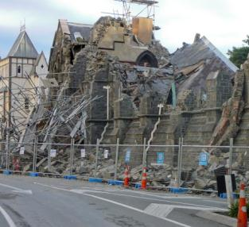
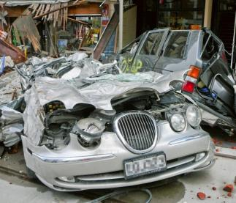
Putting the survey into context…
Before interpreting research results it is useful to consider the context, or events that occurred, prior to fieldwork (16 May to 12 June 2011).
Factors that may have influenced the results include:
Earthquakes (September and February) and aftershocks in Christchurch, and continued media coverage (fieldwork was completed before June 13 quakes)
March Get Ready Get Thru TV advertising was cancelled following February earthquake
Volcanic eruptions in Chile (June) and Iceland (May)
Tornado in Albany (May)
Floods in Mississippi (May)
Earthquake and tsunami in Japan (March)
Cyclone Yasi hit northern Queensland (February)
Floods in Queensland (December/January)
Pike River Mine disaster (November)

Slide 11
There is greater awareness of potential earthquakes and storms this year.
Possible disasters in your lifetime
Awareness of tsunami increased in 2010, and has remained high this year relative to 2009.
(53)
(53)
1% of respondents mentioned mining disasters this year. This has not been mentioned previously. Mentions of mining disasters were highest on the West Coast (3%).
(5)
Q1 First I’d like to ask about the types of major disasters that could happen in New Zealand. What types of disasters can you think of that could happen in New Zealand in your lifetime? Base: All Respondents: Benchmark (n= 1001), 2007 (n= 1000), 2008 (n= 1016), 2009 (n=1000), 2010 (n=1000), 2011 (n=1164). Note: Only the top ten disasters for 2011 are shown.

Slide 12
There have been increases in non-advertising preparedness messages from a range of sources.
Sources of non-advertising preparedness messages
(31)
(17)
As may be expected given recent events, there have been significant increases in non-advertising preparedness messages this year on TV, in newspapers, over the radio, on the internet, and through word of mouth.
(7)
(4)
Q22a Other than in any advertising, where else have you seen or heard other messages or information about disasters? Base: All Respondents, 2009 (n = 1000), 2010 (n=1000), 2011 (n=1164) Note: Statements 2% and below not shown.

Slide 13
How have the Canterbury earthquakes influenced New Zealand’s preparedness?

Slide 14
Attitudes toward disasters have changed.
% agree
Benchmark
2007
2008
2009
2010
2011
61
67
71
76
64
74
This year through the media we have witnessed the response of the Government, Civil Defence, local authorities, emergency services, the New Zealand public and the local community to the Christchurch earthquakes.
This appears to have produced greater confidence that someone will be there to help.
In a disaster there will be someone there to help you
(65)
Benchmark
2007
2008
2009
2010
2011
65
70
75
77
65
75
In a disaster, emergency services would be there to help you
Benchmark
2007
2008
2009
2010
2011
25
31
30
38
36
28
There will always be adequate warning before disaster hits
This year more people appreciate that a disaster could strike at any time.
(37)
Benchmark
2007
2008
2009
2010
2011
94
97
98
98
99
98
It’s my responsibility to look after myself & family in a disaster
Don’t know
Strongly disagree
Slightly disagree
Slightly agree
Strongly agree
Q2 On a scale of strongly agree, slightly agree, slightly disagree and strongly disagree, how much do you agree or disagree with the following statements? Base: All Respondents: Benchmark (n=1001), 2007 (n= 1000), 2008 (n=1016), 2009 (n=1000), 2010 (n=1000), 2011 (n=1164).

Slide 15
We expect to rely more on our local or regional council than we did last year.
Who would be able to help following a disaster?
More people believe their local or regional council, their neighbours, and the ambulance service will be there to help them following a disaster.
(80)
(77)
(67)
(61)
(62)
Q7. Now I’d like you to imagine that there has been a disaster in the town, city or rural area where you live. What groups or individuals do you think would be able to help you following a disaster? Base: All Respondents: 2007 (n= 1000), 2008 (n=1016), 2009 (n=1000), 2010 (n=1000), 2011 (n=1164).

Slide 16
People have become more aware that mobile phone and sanitation services could be disrupted following a disaster.
Which services could be disrupted?
(87)
(82)
Q8 Still imagining there had been a disaster, some of the normal services may not be available. Which of the following household utilities or infrastructure services do you think could be disrupted? Base: All Respondents: 2007 (n= 1000), 2008 (n=1016), 2009 (n=1000), 2010 (n=1000), 2011 (n=1164).

Slide 17
People are more likely to say it’s ‘very important’ to be prepared this year.
% important/ prepared
% of those who say it’s important who also say they are very or quite prepared
94
52
2006 – 54%
93
52
2007 – 54%
95
54
2008 – 56%
2009 – 52%
95
50
2010 – 54%
95
52
(96)
2011 – 62%
96
60
Self-rated preparedness has also increased, from 52% in 2010 to 60% this year.
Not at all important/ prepared
Not that important/ prepared
Quite important/ prepared
Very important/ prepared
Q3 How important is it that you are prepared for a disaster? Is it… Q5. How well prepared for a disaster do you feel you are? Do you feel you are… Base: All Respondents: Benchmark (n=1001), 2007 (n= 1000), 2008 (n= 1016), 2009 (n=1000), 2010 (n=1000), 2011 (n=1164).

Slide 18
More people are aware of the need for an emergency survival plan this year.
Unprompted awareness of what households should do to prepare for a disaster
 | 2009 | 2010 | 2011
Maintain supplies of food and/or water | 76% | 81% | 74%
Maintain food and water supplies | 50% | 53% | 58%
Have an emergency/survival plan | 42% | 39% | 47%
Have a survival or emergency plan that covers away from home | 25% | 17% | 22%
Other ways to prepare
Have an emergency supply of essential items (other than food/water) | 78% | 73% | 77%
Discuss with family and friends | 12% | 6% | 11%
View Civil Defence advice (ie webpage, Yellow Pages) | 6% | 5% | 6%
Regularly check/update supplies for an emergency | 4% | 3% | 3%
Investigate hazards and risks in my area | 3% | 4% | 4%
Keep documents, valuables in a safe place | 3% | 3% | 5%
Maintain insurance coverage | 1% | - | 1%
Other | 4% | 5% | 14%
Don’t know | 3% | 3% | 3%
Q6a What things do you think households should do to prepare for a disaster?
Base: All Respondents: 2009 (n=1000), 2010 (n=1000), 2011 (n=1164). Note: This question was asked for the first time in 2009.

Slide 19
60% say they have taken steps to prepare in the last 12 months.
People more likely to have taken steps to prepare:
Those aged 30 years or over (64%, cf. 48% of those under 30)
NZ European and Maori (61%, cf. 52% of others)
Those with a personal income over $100k (74%, cf. 59% of those earning less)
Those living in small towns or on farms (65%, cf. 58% of those living in main or provincial cities).
(55)
This is a substantial increase since the previous wave.
(44)
Q11a: In the last 12 months, have you taken any steps to prepare yourself or your household for a disaster? Base: All Respondents, 2009 (n = 1000), 2010 (n=1000), 2011 (n=1164)

Slide 20
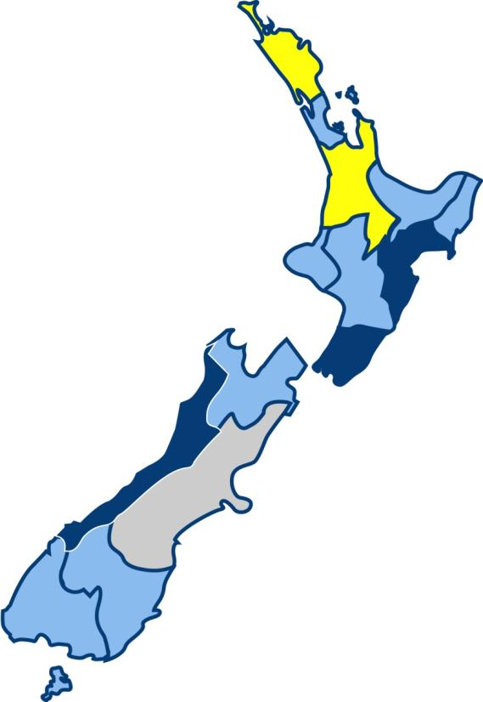
Taken steps to prepare in the last 12 months.
Northland
38%
Higher than average
Average
Below Average
Waikato
43%
Average
60%
Hawkes Bay
76%
Wellington
83%
A higher than average proportion of Wellington, Hawkes Bay, and West Coast residents have taken steps to prepare in the last 12 months. A lower than average proportion of Northland and Waikato residents have taken steps to prepare.
West Coast
78%
Note: Percentages are presented that are statistically higher or lower than the national average at the 95% confidence level. We have not calculated percentages for Canterbury because Christchurch city residents were not interviewed this year.

Slide 21
The Christchurch earthquakes were the main prompt for those who took steps to prepare.
Disasters that occurred in New Zealand
(18)
65% specifically said (unprompted) that it was the Christchurch earthquakes that prompted them to take steps to prepare.
Disasters that occurred overseas
Advertising I saw/heard/read
(24)
3% specifically mentioned the Queensland floods
News/article in the media
(14)
Friends or family
Something I have always done
My work/job training makes me aware
(5)
Just want to be prepared
Common sense/ sensible thing to
Documentary on television
(5)
Q11b: What prompted you to do this? Base: Those who have taken steps towards preparing for a disaster in the last 12 months, 2009 (n = 422), 2010 (n = 465), 2011 (n = 726). Note: The top ten responses are shown.

Slide 22
When prompted, 60% of all those surveyed say they took steps to prepare as a result of either the February or September quake.
Don’t know
September earthquake
Overall 60% say they took steps to prepare as a result of the two major earthquakes:
41% took action after the September quake and 47% took action after the February quake.
Neither
February earthquake
Both earthquakes
Q11c: Did either the September 2010 or February 2011 Christchurch earthquakes prompt you to take steps to prepare yourself or your household for a disaster? Base: All respondents (n=1164)

Slide 23
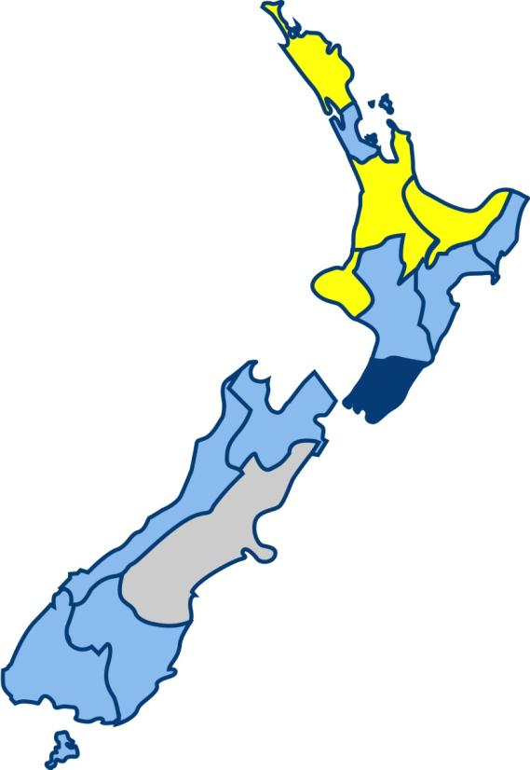
Taken steps to prepare as a result of the Christchurch earthquakes.
Northland
38%
Bay of Plenty
47%
Higher than average
Waikato
46%
Average
Below Average
Taranaki
46%
Average
60%
Wellington
81%
When prompted, a higher than average proportion of Wellington residents say they took steps to prepare as a result of the Christchurch earthquakes. A lower than average proportion of Northland, Bay of Plenty, Waikato, and Taranaki residents say they were prompted to prepare due to the Christchurch earthquakes.
Note: Percentages are presented that are statistically higher or lower than the national average at the 95% confidence level. We have not calculated percentages for Canterbury because Christchurch city residents were not interviewed this year.

Slide 24
Of those who took steps to prepare, 62% prepared survival items and 41% formulated a survival plan.
What was it the Christchurch earthquake(s) prompted you to do? | % of those prompted by earthquakes to prepare (n=711) | % of all those surveyed (n=1164)
To prepare emergency survival items | 62% | 38%
Check/update survival kit/supplies for an emergency | 25% | 15%
Put survival kit/emergency supplies together | 23% | 14%
Store away/purchase survival items (other than water/food) | 19% | 12%
Store away/purchase water | 15% | 9%
Store away/purchase food | 12% | 8%
To formulate a survival plan | 41% | 25%
Make a plan for what to do if there’s a disaster | 28% | 17%
Talk to family/friends about what to do in a disaster | 21% | 13%
To be more aware/prepared (general) | 36% | 22%
Think about preparing for a disaster | 23% | 14%
Raised/heightened awareness/knowledge of disasters | 10% | 6%
To be prepared/more prepared | 6% | 4%
Take other actions | 9% | 5%
Other | 6% | 4%
Similar responses in this table have been grouped into ‘nett categories’.
These nett categories are shaded and in bold font. They show the proportion of respondents who gave at least one of the more detailed responses in that category.
‘Take other actions’ includes putting documents and valuables in a safe place (2%), securing household items (2%), checking insurance coverage (1%), reading Civil Defence advice (1%), and checking house structure (1%).
Q11d: What was it the Christchurch earthquake(s) prompted you to do? Note: Comments below 2% are not shown.

Slide 25
How prepared are people in New Zealand in 2011?

Slide 26
The number of people with survival items, stored water, and a plan has increased since last wave.
You have a good understanding of effects if disaster struck your area
(81)
You have good understanding of types of disasters that could occur in NZ & the chances of them occurring
(80)
You have the necessary emergency items needed to survive a disaster, e.g. tinned food etc
You are familiar with CD info in Yellow Pages
(61)
You have an emergency survival plan for your household
You regularly update your emergency survival items
(45)
You have stored 3L water pp for 3 days for household
You attend meetings with community groups about disaster planning
(8)
None of these
(2)
Q10 Which of the following statements apply to you?
Base: All Respondents: Benchmark (n= 1001), 2007 (n= 1000),
2008 (n= 1016), 2009 (n=1000), 2010 (n=1000), 2011 (n=1164)

Slide 27
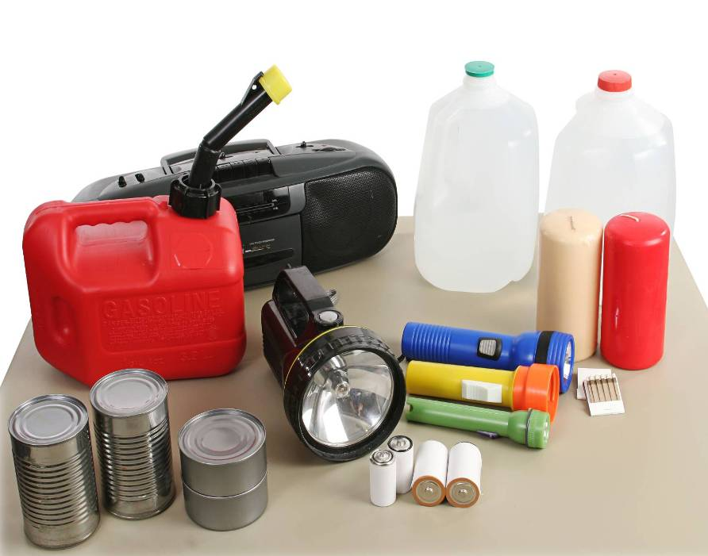
84% have emergency survival items.
Q10. You have necessary emergency items needed to survive a disaster, e.g. tinned food etc
Base: All Respondents: Benchmark (n= 1001), 2007 (n= 1000), 2008 (n= 1016), 2009 (n=1000), 2010 (n=1000), 2011 (n=1000)

Slide 28
More people have a survival plan, and more include a plan for what to do when away from home.
(26)
*Percentages do not add to 100 due to rounding
Q11 Does your survival plan include what to do when you are not at home?
Base: All Respondents: Benchmark (n= 1001), 2007 (n= 1000), 2008 (n= 1016), 2009 (n=1000), 2010 (n=1000), 2011 (n=1164).

Slide 29
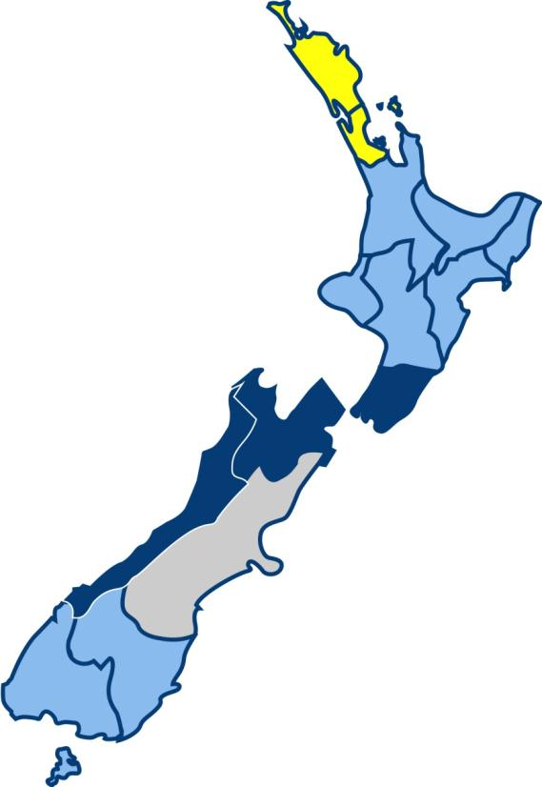
Nearly two thirds (63%) have a plan when at home.
Northland
45%
Higher than average
Average
Auckland
53%
Below Average
Average
63%
Nelson / Tasman / Marlborough
80%
Wellington, Nelson/Tasman/Marlborough, and West Coast residents are more likely than average to have a plan for when at home. Northland and Auckland residents are less likely to have a plan for when at home.
Wellington
79%
West Coast
79%
Note: Percentages are presented that are statistically higher or lower than the national average at the 95% confidence level. We have not calculated percentages for Canterbury because Christchurch city residents were not interviewed this year.

Slide 30
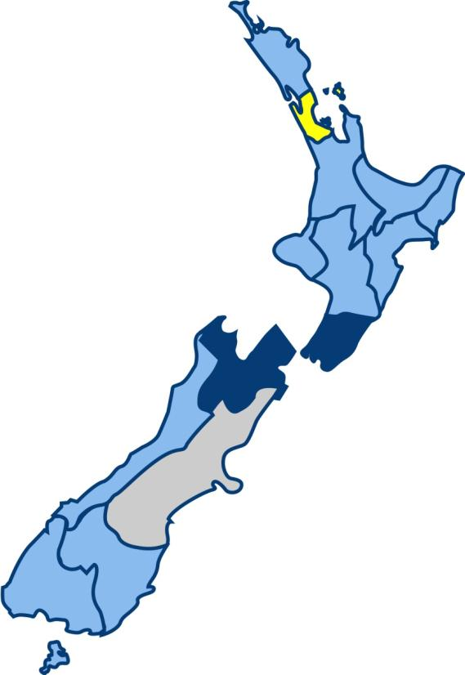
One in three (30%) have a survival plan for when they are away from home.
Auckland
23%
Higher than average
Average
Below Average
Nelson / Tasman / Marlborough
57%
Average
30%
Wellington
45%
Wellington and Nelson/Tasman/Marlborough residents are more likely than average to have a plan for when they are away from home. Auckland residents are less likely to have a plan for when away from home.
Note: Percentages are presented that are statistically higher or lower than the national average at the 95% confidence level. We have not calculated percentages for Canterbury because Christchurch city residents were not interviewed this year.

Slide 31
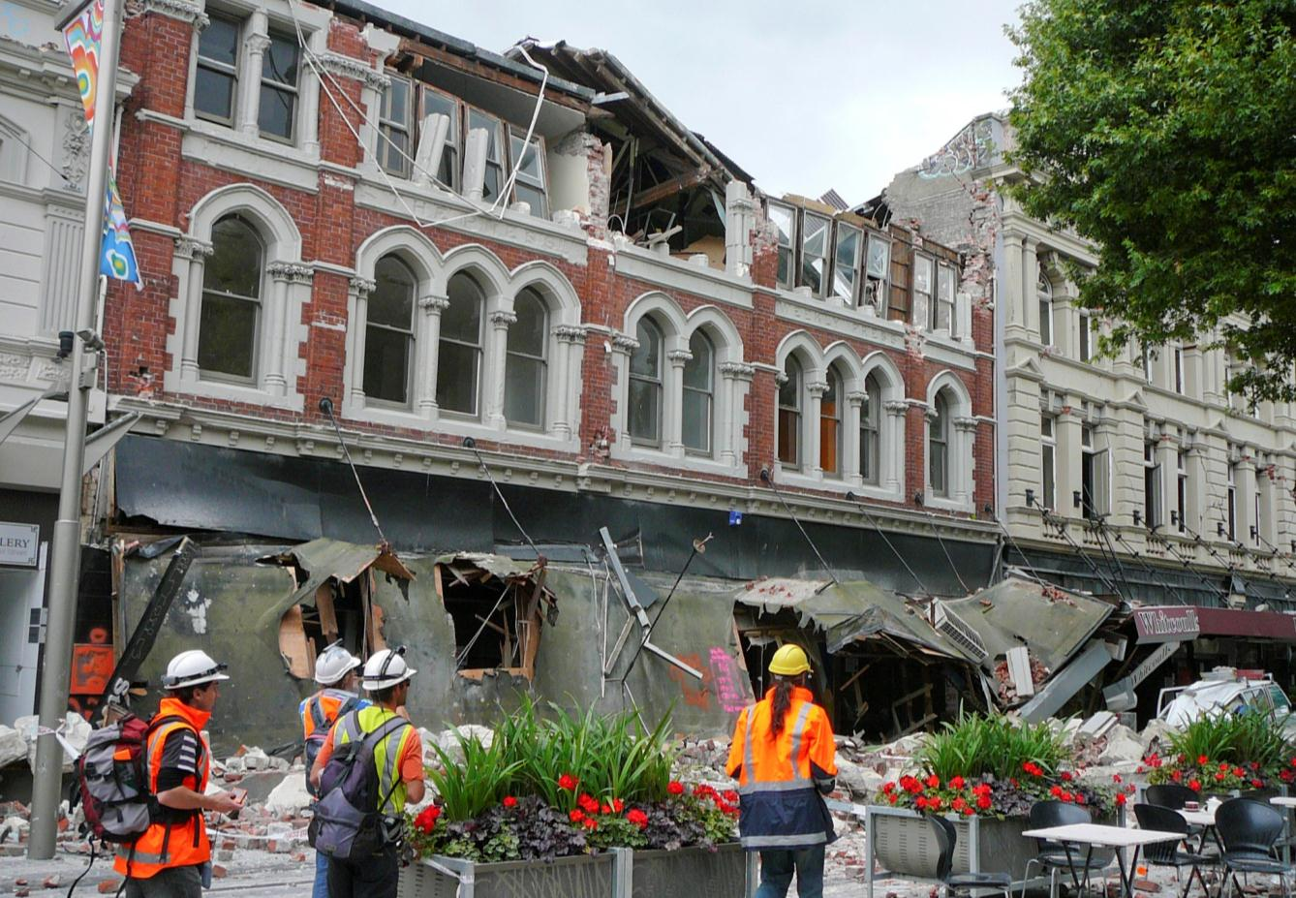
How prepared is New Zealand?
Nearly one out of five are fully prepared.
Have an emergency survival plan that includes what to do when not at home
Have emergency items and water
Regularly update emergency survival items
FULLY PREPARED = 18%
11% - 2010 measure
10% - 2009 measure
10% - 2008 measure
8% - 2007 measure
7% - Benchmark

Slide 32
You have a good understanding of effects if disaster struck your area
(81)
You have good understanding of types of disasters that could occur in NZ & the chances of them occurring
(80)
This change has been driven mostly by the substantial increase in the number of people with a survival plan.
You have the necessary emergency items needed to survive a disaster, e.g. tinned food etc
You are familiar with CD info in Yellow Pages
(61)
You have an emergency survival plan for your household
You regularly update your emergency survival items
(45)
You have stored 3L water pp for 3 days for household
You attend meetings with community groups about disaster planning
(8)
None of these
(2)
Q10 Which of the following statements apply to you?
Base: All Respondents: Benchmark (n= 1001), 2007 (n= 1000),
2008 (n= 1016), 2009 (n=1000), 2010 (n=1000), 2011 (n=1164)

Slide 33
Nearly one fifth (18%) are fully prepared.
Higher than average
Auckland
11%
Average
Below Average
Nelson / Tasman / Marlborough
37%
Average
18%
Wellington
33%
Wellington and Nelson/Tasman/Marlborough residents are more likely than average to be fully prepared. Auckland residents are less likely than average to be fully prepared.
Note: Percentages are presented that are statistically higher or lower than the national average at the 95% confidence level. We have not calculated percentages for Canterbury because Christchurch city residents were not interviewed this year.

Slide 34
Preparedness continuum.
Bench-mark
2007
2008
2009
2010
2011
Fully prepared
18%
7%
8%
10%
10%
11%
Commitment
Have water and survival items
39%
41%
43%
41%
43%
49%
Understanding
Have a good understanding of the effects if disaster struck
77%
81%
79%
80%
80% (81%)
84%
Awareness
Have an understanding of the types of disasters that could occur
83%
82%
82%
81%
79% (80%)
82%
Unaware
17%
18%
18%
19%
21% (20%)
18%

Slide 35
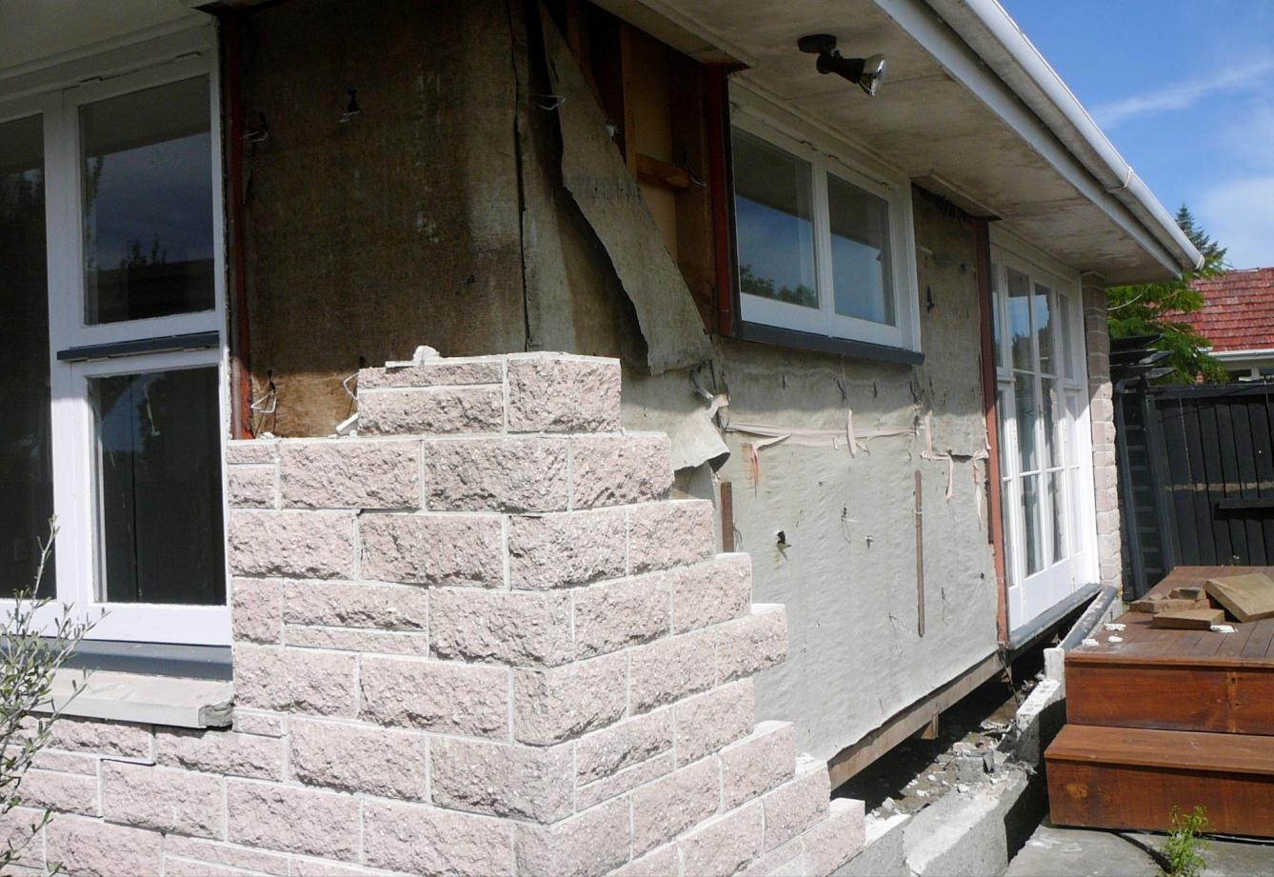
How prepared is New Zealand (when at home)?
One third are prepared at home.
Have an emergency survival plan
Have emergency items and water
Regularly update emergency survival items
PREPARED AT HOME = 32%
24% (23%) - 2010 measure
23% - 2009 measure
26% - 2008 measure
24% - 2007 measure
21% - Benchmark

Slide 36
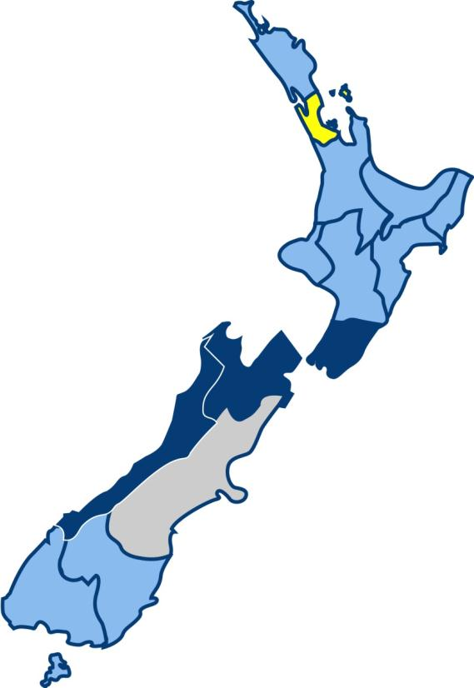
One third (32%) are prepared at home.
Auckland
21%
Higher than average
Average
Below Average
Nelson / Tasman / Marlborough
51%
Average
32%
Wellington
51%
Wellington, Nelson/Tasman/Marlborough, and West Coast residents are more likely than average to be prepared at home. Auckland residents are less likely than average to be prepared at home.
West Coast
53%
Note: Percentages are presented that are statistically higher or lower than the national average at the 95% confidence level. We have not calculated percentages for Canterbury because Christchurch city residents were not interviewed this year.

Slide 37
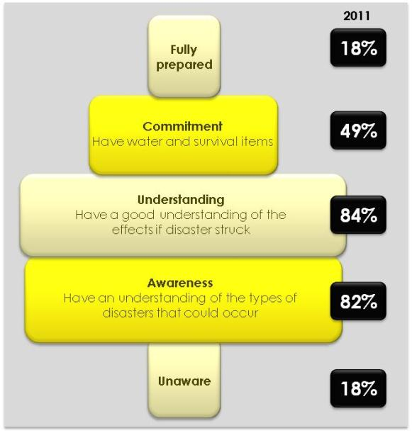
Most at risk when disaster strikes…
Students:
Less likely to be fully prepared (9%) or committed (30%), and to have understanding (63%) or awareness (62%).
More likely to be unaware (38%).
Those who do not identify as NZ European or Māori:
Less likely to be fully prepared (13%) or committed (40%), and to have understanding (68%) or awareness (71%).
More likely to be unaware (29%).
Those for whom English is not a first language:
Less likely to be fully prepared (11%) or committed (40%), and to have understanding (62%) or awareness (70%).
More likely to be unaware (30%).

Slide 38
The main barriers to being prepared remain similar to previous years, although cost has become a greater barrier over time.
Cost more likely to be a barrier for:
Maori (23%) and Pacific (23%)
Those with a personal income less than $40k per year (22%)
Those with a HH income less than $40k per year (35%)
Barriers to being prepared (among those who believe preparedness is important) | BM | ‘07 | ‘08 | ‘09 | ‘10 | ‘11
Haven’t got around to it/no motivation/no time | 40% | 44% | 34% | 25% | 23% | 32%
Don’t expect it to happen/unlikely to happen | 36% | 29% | 22% | 21% | 17% | 17%
The cost/don’t have enough money | 8% | 5% | 6% | 10% | 11% | 16%
Partly prepared/have some emergency supplies | 6% | 15% | 7% | 10% | 3% | 16%
Complacency | 5% | 3% | 21% | 23% | 23% | 14%
Not enough information on being prepared | 15% | 6% | 4% | 8% | 9% | 9%
Priorities/not a high priority | - | - | - | - | 7% | 6%
Haven’t thought about it/don’t think about disasters | 13% | 10% | 11% | 11% | 8% | 5%
Haven’t got supplies/shortage of emergency survival items | 2% | * | 1% | 4% | 6% | 4%
Don’t know what disaster will occur/what to prepare for | 6% | 9% | 2% | 4% | 3% | 4%
(18%)
(24%)
(6%)
(5%)
Q6. You said that being prepared for a disaster is important, but you are not well prepared for one. What stops you from being prepared? Base: Those who stated that being very well/ quite well prepared for a disaster was important but said that they were not well prepared for one: Benchmark (n=341), 2007 (n=387), 2008 (n=398), 2009 (n=431), 2010 (n=417), 2011 (n=383). Note: Statements 2% and below not shown. *Less than .5%

Slide 39
Awareness of disaster preparedness advertising

Slide 40
Unprompted awareness of any disaster preparedness advertising.
Percentage of NZers who have seen, heard, or read any advertising about preparing for a disaster and the ratecard value of the TV advertising.
*Ratecard value for TV ads
Fewer New Zealanders recall disaster preparedness advertising this year.
(69%)
Advertising recall
Annual ratecard value ($ million)*
The decrease in recall will be due largely to the fact that the March wave of the quarterly Get Ready Get Thru TV advertising was cancelled following the February earthquake.
Q15 Have you seen, heard or read recently any advertising about preparing for a disaster? Base: All Respondents: 2007 (n= 1000), 2008 (n= 1016), 2009 (n=1000), 2010 (n=1000), 2011 (n=1164)

Slide 41
Where seen/heard or read disaster advertising.
Those who do recall disaster preparedness advertising are much more likely to mention newspaper advertising (this is likely to be editorial content as no newspaper advertising was carried out this quarter), and slightly more likely to mention radio advertising this year.
They are less likely to mention TV advertising. Again, this will be due to the cancellation of the March Get Ready Get Thru TV advertising.
Q16 Where did you see, hear or read the ads? Base: Those respondents who stated that they have seen, heard or read advertising about preparing for a disaster, 2007 (n=651), 2008 (n=543), 2009 (n=549), 2010 (n=659), 2011 (n=713). Note: Responses 2% and below not shown.

Slide 42
63% specifically recall the Get Ready Get Thru television advertising.
Prompted recall has decreased only marginally since last year, despite the cancellation of the March Get Ready Get Thru advertisements.
*Ratecard value for TV ads
Recall lower among:
Those for whom English is not a first language (41%, cf. 67% of others)
Those who identify with an Asian ethnic group (42%, cf. 66% of others)
Those over 60 years of age (50%, cf. 67% who are younger)
Those with a HH income under $40k (54%, cf. 66% of others)
Prompted TV advertising recall
Annual ratecard value ($ million)*
Q18. Have you seen any television advertisements for Civil Defence presented by Peter Elliot? The ads featured emergency services, public transport, and hospitals. The ads show what services may not be there to help you in an emergency and what you need to do to help you survive a disaster. Peter also directs us to the Yellow Pages for further information as well as telling us to go to the “Get Ready, Get Thru” website. Base: All Respondents: 2007 (n= 1000), 2008 (n= 1016), 2009 (n=1000), 2010 (n=1000), 2011 (n=1164)

Slide 43
How effective is the advertising?

Slide 44
Diagnostics: The ads are understood, and they’re believable, relevant, helpful, and enjoyable.
% agree
98
97
98
99
98
You understood the ad’s message
97
96
96
96
96
The points made were believable
(97)
91
92
94
92
89
The points made were relevant
92
92
95
92
94
The information was helpful
81
80
85
79
77
You enjoyed watching the ads
64
53
70
57
58
The ads contained new information
20
16
22
18
20
You are getting fed up seeing them
Don’t know
Strongly disagree
Slightly disagree
Slightly agree
Strongly agree
Q19 Thinking about these adverts for the Ministry of Civil Defence and Emergency Management, please tell me whether you strongly agree, slightly agree, slightly disagree or strongly disagree with each of these statements? Base: Those respondents who stated that they had seen the Civil Defence TV advertising, 2007 (n=631), 2008 (n=418), 2009 (n=608), 2010 (n=654), 2011 (n=710).

Slide 45
In the wake of the September earthquake, the ads were a more effective prompt for putting together a kit, making a plan, and talking to friends and family.
81% who have seen the ads have done something as a result.
Q20 What if anything have you done as a result of seeing the ads? Have you…
Base: Those respondents who stated that they had seen the Civil Defence TV advertising, 2007 (n=631), 2008 (n=518), 2009 (n=608), 2010 (n=654), 2011 (n=710).

Slide 46
The tagline has become more familiar throughout the campaign.
Half of those surveyed (49%) recall the tagline
The tagline is particularly familiar to young people aged 15 to 19 (67%), and less familiar to older people aged 50 years or over (33%).
Prompted recall of Get Ready Get Thru tagline
(47%)
Q21. Before I mentioned it earlier, had you previously heard of the tag line “Get Ready, Get Thru”?
Base: All Respondents: 2007 (n= 1000), 2008 (n= 1016), 2009 (n=1000) 2010 (n=1000), 2011 (n=1164)

Slide 47
Awareness of the getthru.govt.nz website is maintained at 40%.
Awareness of the website is lower among:
Those who have not taken steps to prepare in the last 12 months (33%, cf. 45% who have)
Those who believe preparedness for a disaster is less than very important (34%, cf. 43% who believe it is very important)
Those who live in small towns or on farms (32%, cf. 43% of others).
Those aged 50 years or over (27%, cf. 47% of those under 50)
Those with a HH income under $40k (34%, cf. 41% of others)
Those who have been living in NZ for 3 years or less (15%, cf. 40% of others)
Prompted recall of getthru.govt.nz
Q22 And had you also previously heard of the website ‘getthru.govt.nz’?
Base: All Respondents: 2007 (n= 1000), 2008 (n= 1016), 2009 (n=1000), 2010 (n=1000), 2011 (n=1164).

Slide 48
Message take-out.
(11)
Other than ‘be prepared’ the main messages taken from the ads are ‘make sure you have supplies’ and ‘disaster can strike at any time’.
(10)
(8)
(4)
(5)
Q17. What do you think the ads were trying to tell you? Base: Those respondents who stated that they have seen or heard advertising about preparing for a disaster, 2009 (n=549), 2010 (n=659).
Note: Statements 2% and below not shown.

Slide 49
Action

Slide 50
Finding information before a disaster.
This year respondents are much more likely to say they can find information at a Civil Defence website.
(26)
(10)
Q12 Before a disaster, where can you get information about how to prepare for a disaster?
Base: All Respondents: Benchmark (n= 1001), 2007 (n= 1000), 2008 (n= 1016), 2009 (n=1000), 2010 (n=1000), 2011 (n=1164). Note: The top ten results for 2011 are shown.

Slide 51
Actions to take during and after an Earthquake.
(43)
Respondents are more likely to say they need to move to a safe place, and check on family and friends.
The increase in the proportion of people saying ‘go outside/into the open’ needs to be addressed in campaign messaging.
Q9b Now imagine that there is a strong earthquake in your area, what actions should people take during and immediately following a strong earthquake? Base: All Respondents: Benchmark (n= 1001), 2007 (n= 1000), 2008 (n= 1016), 2009 (n=1000), 2010 (n=1000), 2011 (n=1164). Note: nly the top ten results for 2011 are shown.

Slide 52
Actions to take for a Tsunami.
(20)
(15)
(14)
(7)
Q9a Now imagine that a tsunami warning has been issued, what actions should people take when a tsunami warning has been issued? Base: All Respondents: Benchmark (n= 1001), 2007 (n= 1000), 2008 (n= 1016), 2009 (n=1000), 2010 (n=1000), 2011 (n=1164). Note: Statements 2% and below not shown.

Slide 53
Conclusions

Slide 54
Conclusions
Events in Christchurch have given people a ‘real’ understanding of what can happen, and shown that they (and their communities) may need to survive on their own for an extended period following a disaster.
Many people have been prompted by this to take action. As a result, New Zealand’s preparedness has increased substantially.
Nearly one fifth of people (18%) are fully prepared.
Half (49%) have both water and survival items.
The majority are aware of the types of disasters that could occur (82%) and have understanding of the effects if one struck (84%).

Slide 55
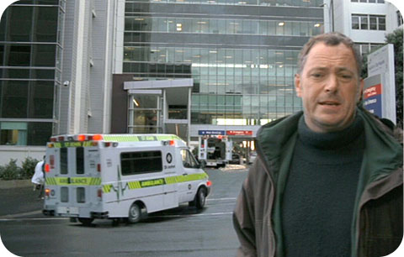
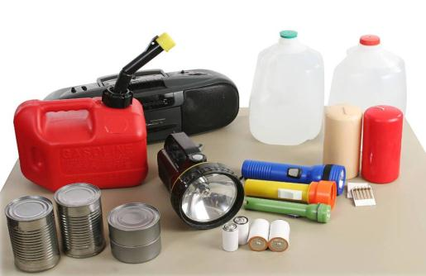
Conclusions (continued)
Awareness of the Civil Defence TV advertising is slightly down on last year, but this was expected given that the March wave was cancelled.
The ads remain an effective prompt for people to take action:
81% of those who have seen the ads have done something as a result
Half of people(49%) now recall the Get Ready Get Thru tagline
40% are now aware of the getthru.govt.nz website.

Slide 56
Challenges
Over time, the impact of the Christchurch earthquakes will lessen. The sense of urgency will dissipate.
So the challenges going forward are:
1. Maintaining preparedness - make sure those who are prepared stay prepared.
They can do this by
Refreshing their emergency supplies
Remembering (recording, writing down) their plan for survival
2. Encouraging action among those who are not yet fully prepared.
Most people already believe it’s important to prepare. They are sold on this.
It’s important they know how to prepare, and what it takes to be fully prepared.
3. Raising awareness among those most at risk.
Students, ethnic minorities and immigrant groups need to know what could happen if disaster strikes, and why they need to prepare.

Slide 57
Regional Analyses

Slide 58
Regional Analyses
The pages that follow list the statistically significant differences between the overall (average) results for NZ and responses provided by people living in the various regions of the country (excluding Christchurch).
This year we carried out additional interviews within each region to allow for more robust analyses. The graph below provides the sample size for each region. The results have been weighted to 2006 Census figures to represent the proportion of New Zealanders aged 15+ within each region and enable comparison with previous waves.
Number of interviews carried out in each region
Please note: Caution must be used in interpreting figures prior to 2011, due to small base sizes within some regions.
Canterbury region results are not shown because we did not interview Christchurch city residents this year. Just 33 people were interviewed in Canterbury. All live outside Christchurch city. These respondents are still included in the national results.
Source: Survey call data (total number of interviews = 1,164)

Slide 59
Auckland
Benchmark
2007
2008
2009
2010
2011
Fully prepared
4%
4%
3%
7%
9%
11%
Prepared at home
15%
15%
14%
20%
18%
21%
Has a plan
38%
39%
35%
40%
40%
53%
Has survival items
83%
83%
67%
74%
75%
79%
Preparedness
Aucklanders are less likely than the national average to be fully prepared (11% are fully prepared, cf. national average of 18%). They are also less likely than average to be prepared at home (21%, cf. 32% national average).
In Auckland, preparedness levels are significantly lower than average in four of the preparedness diagnostics, including:
You are familiar with the Civil Defence information in the Yellow Pages (56%, cf. 67% national average)
You have an emergency survival plan for your household (53%, cf. 63% national average)
You have stored at least 3 litres of water per person for 3 days for each member of your household (41%, cf. 53% national average)
You regularly update your emergency survival items (49%, cf. 56% national average).
Aucklanders are more likely than average to say they are not that well or not at all prepared for a disaster (48%, cf. 40% national average).
Aucklanders are less likely than average to say that they can get information about how to prepare for a disaster from a local or regional council (18%, cf. 27% national average), but more likely than average to say they can get this information from the internet/website (general) (37%, cf. 30% national average).
Sample size = 280

Slide 60
Auckland (continued)
Advertising and information
Advertising about preparing for a disaster is less likely than average to have been seen in newspapers (20%, cf. 33% national average).
Auckland residents are also less likely than average to state that they saw or heard non-advertising information about disasters through local or community newspapers (4%, cf. 8% national average).
Aucklanders who have seen the Civil Defence TV advertising are more likely than average to have taken some action as a result (87%, cf. 81% of all those who have seen the ads).
Disaster awareness
Aucklanders are more likely than average to agree that there will always be adequate warning before a disaster strikes (35%, cf. 28% national average).
Aucklanders are more likely than average to say that hospitals will be there to help following a disaster (71%, cf. 64% national average).
Aucklanders are more likely than average to say that gas (85%, cf. 78% national average) and water services (98%, cf. 89% national average) could be disrupted following a disaster.
Aucklanders are less likely than average to say that a flood could happen in their lifetime (47%, cf. 57% national average). They are more likely than average to say that a volcanic eruption (66%, cf. 51% national average) or a hurricane, cyclone or storm (60%, cf. 53% national average) could happen in their lifetime.
Source: Survey call data (total number of interviews = 1,000)
Sample size = 280

Slide 61
Wellington
Benchmark
2007
2008
2009
2010
2011
Fully prepared
18%
16%
24%
14%
18%
33%
Prepared at home
35%
37%
41%
26%
34%
51%
Has a plan
59%
67%
63%
49%
57%
79%
Has survival items
76%
77%
82%
71%
86%
88%
Preparedness
Overall, a third of Wellington residents are fully prepared for a disaster. This is higher than the national average (18%), and represents an increase from last year (up from 18% to 33%).
Similarly, the proportion of Wellington residents who are prepared at home in the event of a disaster is higher than the national average (51%, cf. 32% national average), and has increased since last year (from 34% to 51%).
Wellington residents are more likely than average to say that they are quite or very well prepared for a disaster (73%, cf. 60% national average). They are also more likely than average to say that people should have an emergency supply of essential items (88%, cf. 77% national average), and an emergency/survival plan (57%, cf. 47% national average) to prepare for a disaster.
The proportion of Wellington residents who have taken steps in the past 12 months to prepare for a disaster is higher than average (83%, cf. 60% national average).
Wellington residents are more likely than average to say they have been prompted to take steps to prepare due to the Christchurch earthquakes (81%, cf. 60% national average).
Of those who say they were prompted to take steps to prepare because of the Christchurch earthquakes, a higher than average proportion say that the Christchurch earthquakes raised their awareness of what could happen in a disaster (19%, cf. 10% national average).
Sample size = 112

Slide 62
Wellington (continued)
Preparedness (continued)
Preparedness levels are significantly higher than average in Wellington for the following three preparedness diagnostics:
You have an emergency survival plan for your household (79%, cf. 63% national average)
You are familiar with the Civil Defence information in the Yellow Pages (77%, cf. 67% national average)
You have stored at least 3 litres of water per person for 3 days for each member in your household (79%, cf. 53% national average).
Wellington residents are more likely than average to say you can get information about how to prepare for a disaster from a Civil Defence website (63%, cf. 44% national average) and the Yellow pages (65%, cf. 52% national average).
Wellington residents are more likely than average to strongly disagree that there will always be adequate warning before disaster strikes (55%, cf. 41% national average).
Advertising and information
Wellington residents are more likely than average to say they have heard of the ‘getthru.govt.nz’ website (51%, cf. 40% national average).
Wellington residents are more likely than average to state that they saw or heard non-advertising information about disasters at work or through workmates (12%, cf. 5% national average).
Disaster awareness
Wellington residents are more likely than average to say that a flood could occur in their lifetime (69%, cf. 57% national average).
Wellington residents are more likely than average to agree that gas (90%, 78% national average), water (96%, cf. 89% national average), sewerage (96%, 88% national average), roading (98%, cf. 90% national average) and access to medical and health services (95%, cf. 88% national average) could be disrupted following a disaster.
Sample size = 112

Slide 63
Waikato
Benchmark
2007
2008
2009
2010
2011
Fully prepared
9%
6%
7%
11%
12%
12%
Prepared at home
21%
22%
19%
18%
21%
34%
Has a plan
44%
46%
45%
50%
47%
57%
Has survival items
68%
91%
81%
75%
80%
86%
Preparedness
Just over one in ten Waikato residents are fully prepared (12%).
Over a third of Waikato residents are prepared at home (34%), and almost six in ten have an emergency plan for when at home (57%).
Over eight in ten Waikato residents have emergency survival items (86%). This has increased over the course of the research (this figure was 68% at the benchmark measure).
However Waikato residents are less likely than average to say they have taken steps in the past 12 months to prepare for a disaster (43%, cf. 60% national average).
Waikato residents are also more likely to say they are not prepared at all for a disaster (17%, cf. 10% national average).
A lower than average proportion of Waikato residents say that the Christchurch earthquakes prompted them to take steps to prepare for a disaster (46%, cf. 60% national average).
A higher than average proportion of Waikato residents say you can get information on how to prepare for a disaster from Civil Defence (19%, cf. 11% national average).
Sample size = 83

Slide 64
Waikato (continued)
Advertising and information
Over six in ten Waikato residents have seen, heard, or read any general advertising about preparing for a disaster (62%), and 65% have specifically seen the Civil Defence television advertising. This is about on par with the national average.
Waikato residents are more likely than average to state that they saw or heard non-advertising information about disasters through local or community newspapers (15%, cf. 8% national average).
Disaster awareness
Waikato residents are less likely than average to say that a tsunami will occur during their lifetime (55%, cf. 70% national average).
In the event of an earthquake, Waikato residents are more likely to say that you should ‘drop, cover and hold’ (16%, cf. 9% national average), and get help as soon as possible (4%, cf. 1% national average).
Sample size = 83

Slide 65
Bay of Plenty
Benchmark
2007
2008
2009
2010
2011
Fully prepared
8%
2%
13%
15%
12%
12%
Prepared at home
16%
16%
34%
28%
22%
34%
Has a plan
43%
42%
57%
54%
47%
66%
Has survival items
67%
82%
90%
78%
81%
87%
Preparedness
Over a third of Bay of Plenty residents are prepared at home this year (34%). This has increased over the course of the research (16% were prepared at home at the benchmark measure).
More Bay of Plenty residents this year say they have an emergency survival plan for their household (66%, up from 47% last year).
Bay of Plenty residents who have taken steps in the past 12 months to prepare for a disaster are less likely than average to say that the Christchurch earthquakes prompted them to take these steps (47%, cf. 60% national average).
Those who did take steps to prepare as a result of the Christchurch earthquakes are more likely than average to give the non-specific response that the earthquake prompted them to ‘generally be more prepared’ (18%, cf. 6% national average).
Sample size = 71

Slide 66
Bay of Plenty (continued)
Advertising and information
Over six in ten Bay of Plenty residents have seen, heard, or read any general advertising about preparing for a disaster (62%).
Around three quarters of Bay of Plenty residents have seen the Civil Defence advertising (74%, cf. 63% national average).
Bay of Plenty residents are less likely than average to state that they heard non-advertising information about disasters via word of mouth (3%, cf. 11% national average). The main source of non-advertising information about disasters was via television (46% say they saw non-advertising information through the television).
Disaster awareness
Bay of Plenty residents are more likely than average to say that in the event of a tsunami warning, people should locate or check their mobile phone (6%, cf. 1% national average).
Sample size = 71

Slide 67
northland
Benchmark
2007
2008
2009
2010
2011
Fully prepared
1%
7%
10%
6%
6%
12%
Prepared at home
13%
33%
24%
25%
34%
25%
Has a plan
37%
51%
42%
56%
55%
45%
Has survival items
87%
91%
93%
80%
74%
84%
Preparedness
A quarter of Northland residents are prepared at home (25%).
Over eight in ten Northland residents have an emergency supply of essential items (84%).
In Northland, preparedness levels are significantly lower than average in four of the preparedness diagnostics, including:
You have a good understanding of the types of disasters that could occur in New Zealand, and the chances of them occurring (67%, cf. 82% national average)
You have a good understanding of what the effects would be if a disaster struck in your area (70%, cf. 84% national average)
You are familiar with the Civil Defence information in the Yellow Pages (52%, cf. 67% national average)
You have an emergency survival plan for your household (45%, cf. 63% national average).
However Northland residents are more likely than average to say they regularly attend meetings with community groups about disaster planning (18%, cf. 10% national average).
Sample size = 65

Slide 68
Northland (continued)
Preparedness (continued)
Northland residents are less likely than average to have taken steps within the past 12 months to prepare for a disaster (38%, cf. 60% national average). Those who have taken steps towards preparing for a disaster in the past twelve months are less likely than average to say that the Christchurch earthquakes prompted them to take these steps (38%, cf. 60% national average), however they are more likely to say that other disasters within New Zealand prompted them to take action (32%, cf. 17% national average).
Advertising and information
Northland residents who have seen, heard, or read any general advertising about preparing for a disaster are more likely to say they have heard this on the radio (32%, cf. 18% national average).
A higher than average proportion of Northland residents say they have done nothing as a result of seeing the Civil Defence advertising (36%, cf. 19% of all who have seen the ads). Similarly, a lower than average proportion say they have talked to family and friends (41%, cf. 60% of all who have seen the ads), or made a survival kit (23%, cf. 42% of all who have seen the ads) after seeing the ads.
Northland residents are less likely than average to say they have seen or heard non advertising information about disasters (29% have not seen any other non advertising information, cf. 16% national average). A lower than average proportion also say they have seen non advertising information on the television (21%, cf. 38% national average), and via the internet (3%, cf. 12% national average), although more say they have heard information via word of mouth (22%, cf. 11% national average).
Disaster awareness
Northland residents are more likely than average to say that a hurricane, cyclone, or storm could occur in their lifetime (67%, cf. 53% national average).
Northland residents are less likely than average to say that following a disaster, a hospital would be available to help (40%, cf. 64% national average).
They are less likely than average to say that in a disaster, mobile phone services would be disrupted (57%, cf. 73% national average).
Sample size = 65

Slide 69
Taranaki
Benchmark
2007
2008
2009
2010
2011
Fully prepared
Sample size too small
Sample size too small
Sample size too small
Sample size too small
Sample size too small
14%
Prepared at home
22%
Has a plan
47%
39%
57%
43%
36%
62%
Has survival items
81%
84%
90%
81%
68%
76%
Preparedness
The proportion of Taranaki residents who have an emergency plan for their household has increased this year (62%, up from 36% last year).
However a higher than average proportion of Taranaki residents say they are not prepared at all for a disaster (23%, cf. 10% national average).
Taranaki residents are more likely than average to mention cost as a barrier to being prepared (31%, cf. 16% national average).
Taranaki residents are less likely than average to say that the Christchurch earthquakes prompted them to take steps to prepare for a disaster (46%, cf. 60% national average). However those that were prompted by these earthquakes are more likely than average to say that they were prompted to check/update their survival kit/emergency supplies (49%, cf. 25% national average), and think about preparing for a disaster (40%, cf. 23% national average).
Sample size = 65

Slide 70
Taranaki (continued)
Advertising and information
Taranaki residents who have seen or heard advertising about preparing for a disaster are more likely than average to say that the ads are trying to tell them how to prepare/what to do when a disaster strikes (35%, cf. 13% national average), and to be aware of what could happen (24%, cf. 12% national average).
A higher than average proportion of Taranaki residents have not seen the Civil Defence television advertising (47%, cf. 33% national average).
Disaster awareness
Taranaki residents are more likely than average to say that a volcanic eruption is a disaster that could occur in New Zealand in their lifetime (81%, cf. 51% national average).
Taranaki residents are less likely than average to say that access to medical and health services could be disrupted following a disaster (74%, cf. 88% national average).
Taranaki residents are less likely than average to agree that land line telephone (82%, cf. 92% national average), sewerage (79%, cf. 88% national average) and medical and health services (74%, cf. 88% national average) could be disrupted following a disaster.
Taranaki residents are more likely than average to say that in the event of a tsunami, people should move inland (32%, cf. 19% national average).
Sample size = 65

Slide 71
Manawatu
Benchmark
2007
2008
2009
2010
2011
Fully prepared
6%
16%
16%
15%
7%
20%
Prepared at home
28%
34%
30%
33%
22%
36%
Has a plan
52%
63%
55%
65%
50%
67%
Has survival items
85%
97%
76%
94%
82%
80%
Preparedness
The proportion of Manawatu residents who are fully prepared has increased this year (from 7% to 20%).
Two thirds of Manawatu residents have an emergency plan for their household (67%).
Manawatu residents are less likely than average to say that to prepare for a disaster, households should have an emergency supply of essential items (63%, cf. 77% national average) or talk with family and friends (3%, cf. 11% national average). They are more likely than average to say you should view Civil Defence advice (13%, cf. 6% national average).
Advertising and information
Manawatu residents are less likely than average to say that they have seen, heard or read advertising about preparing for a disaster (47%, cf. 60% national average).
Almost seven in ten (69%) of Manawatu residents have seen the Civil Defence advertising.
Manawatu residents are less likely than average to say that as a result of seeing the ads, they have thought about preparing for disasters (41%, cf. 62% of all who have seen the ads), or talked about it with family and friends (36%, cf. 60% of all who have seen the ads). They are more likely than average to say that they have done nothing as a result of seeing the ads (38%, cf. 19% of all who have seen the ads).
Sample size = 64

Slide 72
Manawatu (continued)
Disaster awareness
Similar to past years, Manawatu residents are more likely than average to say that a flood is a disaster that could occur in their lifetime (72%, cf. 57% national average). They are also more likely to say that a fire could occur in their lifetime (35%, cf. 23% national average).
In the event of an earthquake, Manawatu residents are less likely than average to say people should ‘drop, cover, and hold’ (no respondents mentioned this, cf. 9% national average), however they are more likely to say that you should alert or check on family/friends/neighbours (63%, cf. 49% national average), and stay where you are/stay put (22%, cf. 9% national average).
Sample size = 64

Slide 73
Gisborne
Benchmark
2007
2008
2009
2010
2011
Fully prepared
Sample size too small
Sample size too small
Sample size too small
Sample size too small
Sample size too small
16%
Prepared at home
35%
Has a plan
62%
42%
68%
40%
72%
59%
Has survival items
100%
87%
87%
92%
80%
82%
Preparedness
In Gisborne, preparedness levels are significantly higher than average in the following preparedness diagnostics:
You have a good understanding of the types of disasters that could occur in New Zealand, and the chances of them occurring (95%, cf. 82% national average)
You have a good understanding of what the effects would be if a disaster struck in your area (94%, cf. 84% national average).
When it comes to information about preparing for a disaster, Gisborne residents are more likely than average to say they can get information from a local or regional council (42%, cf. 27% national average).
Gisborne residents who have taken steps in the past 12 months to prepare for a disaster are more likely than average to say that disasters that have occurred in New Zealand (other than the Christchurch earthquake) (37%, cf. 17% national average) and tsunami warnings (11%, cf. 2% national average) have prompted them to take these steps.
Sample size = 65

Slide 74
Gisborne (continued)
Advertising and information
Around seven in ten (71%) Gisborne residents have seen, heard, or read any general advertising about preparing for a disaster (60% is the national average).
Gisborne residents are more likely than average to have heard advertising about preparing for a disaster through the radio (32%, cf. 18% national average), but less likely to have seen advertising through the newspaper (19%, cf. 33% national average).
Gisborne residents are more likely than average to say they have not seen any non advertising information about disasters (27%, cf. 16% national average).
Disaster awareness
Gisborne residents are more likely than average to say that a tsunami is a disaster that could occur in their lifetime (91%, cf. 70% national average). They are less likely to say that a hurricane, cyclone, or storm (27%, cf. 53% national average), or a volcanic eruption (37%, cf. 51% national average) could occur in their lifetime.
Gisborne residents are less likely than average to agree the army will be there to help following a disaster (45%, cf. 63% national average).
Gisborne residents are less likely than average to agree that land line telephone (83%, cf. 92% national average), water (75%, cf. 89% national average), and sewerage services (76%, cf. 88% national average could be disrupted following a disaster.
Gisborne residents are most likely to say that in the event of an earthquake, people should alert or check on family, friends and neighbours (58% say this), and take shelter under a desk/doorway (40% say this). However they are less likely than average to say that in the event of an earthquake, people should move to a safe place (37%, cf. 50% national average).
Sample size = 65

Slide 75
Hawkes Bay
Benchmark
2007
2008
2009
2010
2011
Fully prepared
13%
7%
16%
12%
7%
16%
Prepared at home
26%
26%
29%
29%
20%
28%
Has a plan
59%
54%
64%
59%
63%
71%
Has survival items
88%
80%
73%
87%
79%
84%
Preparedness
Seven in ten (71%) Hawkes Bay residents have an emergency plan for their household.
Over eight in ten (84%) have an emergency supply of essential items to survive a disaster.
Hawkes Bay residents are more likely than average to have taken steps in the past twelve months to prepare for a disaster (76%, cf. 60% national average).
Hawkes Bay residents who have taken steps towards preparing for a disaster in the past twelve months are more likely than average to say that they were prompted to take these steps because of disasters that occurred in New Zealand other than the Christchurch earthquakes (29%, cf. 17% national average).
When it comes to getting information on how to prepare for a disaster, Hawkes Bay residents are more likely than average to say they can get this information from the radio (16%, cf. 7% national average).
Sample size = 65

Slide 76
Hawkes Bay (continued)
Advertising and information
Around six in ten (62%) Hawkes Bay residents have seen, heard, or read any general advertising about preparing for a disaster.
Hawkes Bay residents who have seen or heard advertising about preparing for a disaster are more likely than average to say that they saw ads in the newspaper (51%, cf. 33% national average).
Hawkes Bay residents are more likely than average to say that as a result of seeing the Civil Defence advertising they have talked to family and friends (80%, cf. 60% national average).
Disaster awareness
Hawkes Bay residents are more likely than average to say that a fire is a disaster that could occur in their lifetime (33%, cf. 23% national average). They are less likely to say that a volcanic eruption could occur in their lifetime (29%, cf. 51% national average).
Sample size = 65

Slide 77
Nelson/marlborough
Benchmark
2007
2008
2009
2010
2011
Fully prepared
Sample size too small
Sample size too small
Sample size too small
Sample size too small
Sample size too small
37%
Prepared at home
51%
Has a plan
66%
48%
71%
53%
43%
80%
Has survival items
88%
91%
87%
91%
85%
91%
Preparedness
Nelson/Marlborough residents are more likely than average to be fully prepared (37%, cf. 18% national average), and prepared at home (51%, cf. 32% national average).
Preparedness levels are significantly higher than average in the following two preparedness diagnostics:
You have an emergency survival plan for your household (80%, cf. 63% national average).
You regularly update your emergency survival items (71%, cf. 56% national average).
Nelson/Marlborough residents are more likely than average to say that to prepare for a disaster, households should have an emergency plan that covers away from home (33%, cf. 22% national average) and talk with family and friends (20%, cf. 11% national average).
Nelson/Marlborough residents who have an emergency survival plan for their household are more likely to say that this includes what to do when away from home (71%, cf. 47% of all those with a plan).
Nelson/Marlborough residents are more likely than average to say they can get information on how to prepare for a disaster from a local or regional council (48%, cf. 27% national average).
Sample size = 65

Slide 78
Nelson/marlborough (continued)
Advertising and information
Nelson/Marlborough residents are more likely than average to say they have seen general advertising about preparing for a disaster in newspapers (57%, cf. 33% national average) and magazines (10%, cf. 2% national average).
Nelson/Marlborough residents who have seen or heard advertising about preparing for a disaster are more likely than average to say that the ads are telling them to be aware of what could happen (23%, cf. 12% national average) and that they might not be where they think they will be (12%, cf. 3% national average).
Nelson/Marlborough residents are more likely than average to say they have seen non-advertising information about disasters in the media/news (unspecific)(7%, cf. 2% national average).
Disaster awareness
Nelson/Marlborough residents are less likely than average to say that a volcanic eruption (35%, cf. 51% national average) or a hurricane, cyclone, or storm (40%, cf. 53% national average) is a disaster that could happen in their lifetime.
In the event of an earthquake, Nelson/Marlborough residents are more likely than average to say that people should implement a survival plan (10%, cf. 4% national average) and stay indoors (15, cf. 7% national average).
Sample size = 65

Slide 79
West coast
2011
Fully prepared
24%
*Note, there are no comparative figures provided as this year the West Coast was analysed as a separate region, while in previous years it was combined with Canterbury.
Prepared at home
53%
Has a plan
79%
Has survival items
93%
Preparedness
Residents from the West Coast are more likely than average to be prepared at home (53%, cf. 32% national average).
Preparedness levels in the West Coast are significantly higher than average in the following preparedness diagnostics:
You have a good understanding of the types of disasters that could occur in New Zealand, and the chances of them occurring (96%, cf. 82% national average)
You have a good understanding of what the effects would be if a disaster struck in your area (96%, cf. 84% national average)
You are familiar with the Civil Defence information in the Yellow Pages (80%, cf. 67% national average)
You have an emergency survival plan for your household (79%, cf. 63% national average)
You have stored at least 3 litres of water per person for 3 days for each member in your household (71%, cf. 53% national average)
You have the necessary emergency items needed to survive a disaster (93%, cf. 84% national average)
You regularly update your emergency survival items (83%, cf. 56% national average).
Sample size = 66

Slide 80
West coast (continued)
Preparedness (continued)
West Coast residents are more likely than average to say that being prepared for a disaster is very important (81%, cf. 63% national average).
They are also more likely to say that they are quite well or very well prepared for a disaster (84%, cf. 60% national average).
West Coast residents are more likely than average to say that to prepare for a disaster, households should maintain food and water supplies (73%, cf. 58% national average) and have an emergency supply of essential items (92%, cf. 77% national average).
A higher than average proportion of West Coast residents have taken steps to prepare for a disaster in the past twelve months (78%, cf. 60% national average).
Of those who were prompted to prepare due to the Christchurch earthquakes, a higher than average proportion of West Coast residents say that they were prompted to check/update emergency supplies as a result (55%, cf. 25% national average).
Advertising and information
West Coast residents are more likely than average to have seen advertising about preparing for a disaster in the newspapers (49%, cf. 33% national average).
After seeing the Civil Defence TV ads, West Coast residents are more likely than average to have visited the Get Ready Get Thru website (27%, cf. 14% national average).
West Coast residents are more likely than average to have heard of the ‘Get Ready Get Thru’ tagline (66%, cf. 49% national average).
Sample size = 66

Slide 81
West coast (continued)
Disaster Awareness
Residents from the West Coast are less likely than average to say that a volcanic eruption is a disaster that could occur in New Zealand in their lifetime (35%, cf. 51% national average).
In terms of services that could be disrupted following a disaster, West Coast residents are more likely than average to say that mobile phone services (86%, cf. 73% national average) and access to medical and health services (98%, cf. 88% national average) could be disrupted.
In the event of a tsunami, West Coast residents are more likely than average to say that people should prepare to be evacuated/take important personal items (29%, cf. 16% national average).
In the event of an earthquake, West Coast residents are more likely than average to say that people should alert or check on family/friends and neighbours (65%, cf. 49% national average), and prepare to be evacuated/take important personal items (18%, cf. 6% national average).
Sample size = 66

Slide 82
Otago
Benchmark
2007
2008
2009
2010
2011
Fully prepared
5%
17%
4%
3%
8%
23%
Prepared at home
15%
32%
18%
14%
29%
37%
Has a plan
53%
44%
43%
60%*
59%
71%
Has survival items
94%
86%
82%
89%
88%
85%
Preparedness
Compared to last year, more Otago residents are fully prepared for a disaster (up from 8% to 23% this year).
A greater than average proportion of Otago residents are familiar with the Civil Defence information in the Yellow Pages (82%, cf. 67% national average).
Otago residents are more likely than average to say that cost is a barrier to being prepared (36%, cf. 16% national average).
Otago residents are less likely than average to say it is very important to be prepared for a disaster (49%, cf. 63% national average).
Advertising and information
Two thirds (66%) of Otago residents have seen, heard or read any general advertising about preparing for a disaster.
Over seven in ten (72%) Otago residents have seen the Civil Defence television advertising.
Sample size = 65

Slide 83
Otago (continued)
Disaster awareness
Otago residents are more likely than average to strongly disagree that in a disaster there will be someone there to help (19%, 10% national average), and that there will always be adequate warning before disaster strikes (61%, cf. 41% national average). They are more likely to disagree that emergency services will be there to help (31%, cf. 23% national average).
Otago residents are less likely than average to say that a hurricane, cyclone, or storm (33%, cf. 53% national average) or a fire will occur in New Zealand during their lifetime (11%, cf. 23% national average). They are more likely to say that a snow storm will occur in New Zealand during their lifetime (6%, cf. 1% national average).
Otago residents are less likely than average to agree the army will be there to help following a disaster (50%, cf. 63% national average)
Otago residents are less likely than average to agree that gas services could be disrupted following a disaster (65%, cf. 78% national average).

Slide 84
Southland
Benchmark
2007
2008
2009
2010
2011
Fully prepared
Sample size too small
Sample size too small
Sample size too small
Sample size too small
Sample size too small
20%
Prepared at home
38%
Has a plan
55%
52%
72%
50%
62%
71%
Has survival items
77%
87%
86%
90%
77%
91%
Preparedness
One in five (20%) Southland residents are fully prepared for a disaster.
Over nine in ten (91%) Southland residents have an emergency supply of essential items.
Southland residents who have taken steps to prepared for a disaster are more likely than average to say it was the Christchurch earthquakes that prompted them (82%, cf. 65% national average). Southland residents are less likely than average to say that overseas disasters prompted them to prepare for a disaster (7%, cf. 24% national average).
Advertising and information
Two thirds (67%) of Southland residents have seen, heard, or read any general information about preparing for a disaster.
Southland residents are less likely than average to have thought about preparing for a disaster (46%, cf. 62% national average), or talked to family and friends (43%, cf. 60% national average) as a result of seeing the Civil Defence TV advertising.
Southland residents are more likely than average to say they have heard non-advertising information about disasters through the radio (33%, cf. 21% national average).
Sample size = 65

Slide 85
Southland (continued)
Disaster awareness
Southland residents are more likely than average to strongly disagree that there will be someone there to help following a disaster (20%, cf. 10% national average) and that there will always be adequate warning before disaster strikes (56%, cf. 41% national average).
Southland residents are less likely to say that a hurricane, cyclone, or storm (34%, cf. 53% national average), a tsunami (58%, cf. 70% national average), or a volcanic eruption (27%, cf. 51% national average) is a disaster that could occur in their lifetime.
In the event of an earthquake, Southland residents are more likely than average to say that you should alert/check on family and friends (76%, cf. 49% national average), and listen to the radio for further information (21%, cf. 8% national average).
Sample size = 66

